Slide 1
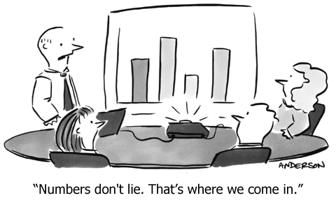
1.1: Analyzing Categorical Data

Slide 2
Section 1.1 Analyzing Categorical Data
After this section, you should be able to…
CONSTRUCT and INTERPRET bar graphs and pie charts
RECOGNIZE “good” and “bad” graphs
CONSTRUCT and INTERPRET two-way tables
DESCRIBE relationships between two categorical variables
ORGANIZE statistical problems

Slide 3
Analyzing Categorical Data
Categorical Variables place individuals into one of several groups or categories
The values of a categorical variable are labels for the different categories
The distribution of a categorical variable lists the count or percent of individuals who fall into each category.
Frequency Table
Format | Count of Stations
Adult Contemporary | 1556
Adult Standards | 1196
Contemporary Hit | 569
Country | 2066
News/Talk | 2179
Oldies | 1060
Religious | 2014
Rock | 869
Spanish Language | 750
Other Formats | 1579
Total | 13838
Relative Frequency Table
Format | Percent of Stations
Adult Contemporary | 11.2
Adult Standards | 8.6
Contemporary Hit | 4.1
Country | 14.9
News/Talk | 15.7
Oldies | 7.7
Religious | 14.6
Rock | 6.3
Spanish Language | 5.4
Other Formats | 11.4
Total | 99.9
Variable
Values
Count
Percent

Slide 4
Distribution & Categorical Variables
The distribution of a categorical variable lists the count or percent of individuals who fall into each category.
Favorite Course | Count
English | 8
Foreign Language | 4
Histroy | 11
Math | 15
Science | 12
Favorite Course | Percentage
English | 16%
Foreign Language | 8%
Histroy | 22%
Math | 30%
Science | 24%

Slide 5
Displaying Categorical Data
Frequency tables can be difficult to read. Sometimes it is easier to analyze a distribution by displaying it with a bar graph or pie chart.

Slide 6
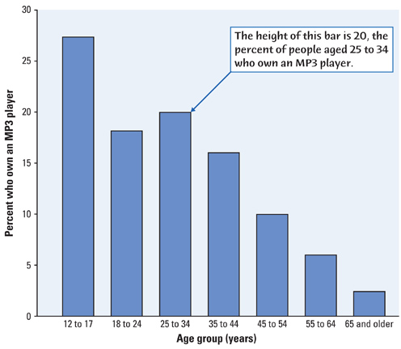
Do you listen to an MP3 Player?
Could you make a pie graph from this data?

Slide 7
Displaying Categorical Variables
Pie Charts
NOT all categorical data can be displayed as a pie chart!

Slide 8
Graphs: Good and Bad
Bar graphs compare several quantities by comparing the heights of bars that represent those quantities.
Our eyes react to the area of the bars as well as height. Be sure to make your bars equally wide.
Avoid the temptation to replace the bars with pictures for greater appeal…this can be misleading!
This ad for DIRECTV has multiple problems. How many can you point out?
Notes:
Alternate Example: The following ad for DIRECTV has multiple problems. See how many your students can point out. First, the heights of the bars are not accurate. According to the graph, the difference between 81 and 95 is much greater than the difference between 56 and 81. Also, the extra width for the DIRECTV bar is deceptive since our eyes respond to the area, not just the height.

Slide 9
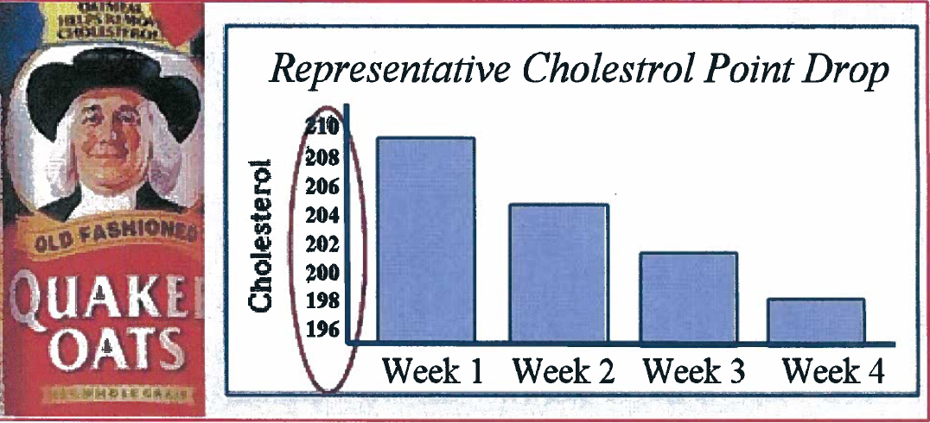
Bad Graphs with counts

Slide 11
Two-Way Tables
Two-Way Tables: describe two categorical variables, organizing counts according to a row variable and a column variable.
When a dataset involves two categorical variables, we begin by examining the counts or percents in various categories for one of the variables.
 | Member of No Clubs | Member of One Club | Member of 2 or More Clubs | Total
Rides the School Bus | 55 | 33 | 20 | 108
Does not Ride Bus | 16 | 44 | 82 | 142
Total | 71 | 77 | 102 | 250
What are the variables described by this two-way table?
How many students were surveyed?
Notes:
Alternate Example: Super Powers
A sample of 200 children from the United Kingdom ages 9-17 was selected from the CensusAtSchool website (www.censusatschool.com). The gender of each student was recorded along with which super power they would most like to have: invisibility, super strength, telepathy (ability to read minds), ability to fly, or ability to freeze time. Here are the results:

Slide 12
Analyzing Categorical Data
Two-Way Tables and Marginal Distributions
Definition:
The Marginal Distribution of one of the categorical variables in a two-way table of counts is the distribution of values of that variable among all individuals described by the table.
Note: Percents are often more informative than counts, especially when comparing groups of different sizes.
To examine a marginal distribution,
Use the data in the table to calculate the marginal distribution (in percents) of the row or column totals.
Make a graph to display the marginal distribution.

Slide 13
Analyzing Categorical Data
Two-Way Tables and Marginal Distributions
Young adults by gender and chance of getting rich
 | Female | Male | Total
Almost no chance | 96 | 98 | 194
Some chance, but probably not | 426 | 286 | 712
A 50-50 chance | 696 | 720 | 1416
A good chance | 663 | 758 | 1421
Almost certain | 486 | 597 | 1083
Total | 2367 | 2459 | 4826
Examine the marginal distribution of chance of getting rich.
Response | Percent
Almost no chance | 194/4826 = 4.0%
Some chance | 712/4826 = 14.8%
A 50-50 chance | 1416/4826 = 29.3%
A good chance | 1421/4826 = 29.4%
Almost certain | 1083/4826 = 22.4%

Slide 14
Analyzing Categorical Data
Relationships Between Categorical Variables
Marginal distributions tell us nothing about the relationship between two variables.
Definition:
A Conditional Distribution of a variable describes the values of that variable among individuals who have a specific value of another variable.
To examine or compare conditional distributions,
Select the row(s) or column(s) of interest.
Use the data in the table to calculate the conditional distribution (in percents) of the row(s) or column(s).
Make a graph to display the conditional distribution.
Use a side-by-side bar graph or segmented bar graph to compare distributions.

Slide 15
Analyzing Categorical Data
Two-Way Tables and Conditional Distributions
Young adults by gender and chance of getting rich
 | Female | Male | Total
Almost no chance | 96 | 98 | 194
Some chance, but probably not | 426 | 286 | 712
A 50-50 chance | 696 | 720 | 1416
A good chance | 663 | 758 | 1421
Almost certain | 486 | 597 | 1083
Total | 2367 | 2459 | 4826
Calculate the conditional distribution of opinion among males.
Examine the relationship between gender and opinion.
Response | Male
Almost no chance | 98/2459 = 4.0%
Some chance | 286/2459 = 11.6%
A 50-50 chance | 720/2459 = 29.3%
A good chance | 758/2459 = 30.8%
Almost certain | 597/2459 = 24.3%
Female
96/2367 = 4.1%
426/2367 = 18.0%
696/2367 = 29.4%
663/2367 = 28.0%
486/2367 = 20.5%

Slide 16
Similar Sounding Questions
Percentage of those who were both in first class and survived.
The percentage of those who survived among those who were in first class.
The percentage of those who were in first class among those who survived.
Pay attention to the “among who” implicitly defined by the phrase.

Slide 17
What proportion of students that ride the school bus are members of two or more clubs?
What proportion of students that are members of no clubs do not ride the school bus?
What proportion of students that do not ride the school bus are members of at least one club?
 | Member of No Clubs | Member of One Club | Member of 2 or More Clubs | Total
Rides the School Bus | 55 | 33 | 20 | 108
Does not Ride Bus | 16 | 44 | 82 | 142
Total | 71 | 77 | 102 | 250

Slide 18
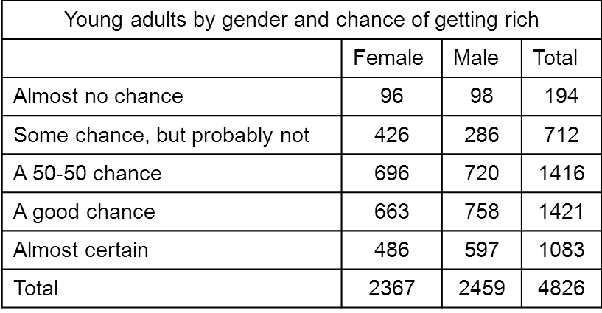
What proportion of males have “a good chance” at being rich?
What proportion of females have a “50-50 chance” at being rich?
What proportion of young adults that have an “almost certain” chance of being rich are male?

Slide 19
Comparing Categorical Distributions
 | Sophomore | Junior | Senior | Total
One | 0 | 0 | 4 | 4
Two | 1 | 3 | 12 | 16
Three | 4 | 7 | 6 | 17
Four | 7 | 4 | 8 | 19
Five | 2 | 0 | 3 | 5
Total | 14 | 14 | 33 | 61

Slide 20
Comparing Categorical Distributions

Slide 21
Comparing Categorical Distributions

Slide 22
Analyzing Categorical Data
Organizing a Statistical Problem
As you learn more about statistics, you will be asked to solve more complex problems.
Here is a four-step process you can follow.
How to Organize a Statistical Problem: A Four-Step Process
State: What’s the question that you’re trying to answer?
Plan: How will you go about answering the question? What statistical techniques does this problem call for?
Do: Make graphs and carry out needed calculations.
Conclude: Give your practical conclusion in the setting of the real-world problem.

Slide 23
Writing to Compare Categorical Distributions
Cite specific numerical values/proportions.
Use comparison words.
Greater, smaller, less, while only, more, wider, narrower, fewer, etc.
Use transition words
However, whereas, similarly, additionally, etc.
Discuss at least two points of comparison.

Slide 24
Comparing Categorical Distributions
Is there an association between after-school club participation and whether or not the student rides the school bus? Support your answer with a discussion of the provided graphs.

Slide 25
Comparing Categorical Distributions
Sample Answer:
Yes, there is a clear association between after-school club participation and transportation. Only 11% of students who don’t ride the bus do not participate in after school clubs, whereas 51% of students who do ride the bus do not participate. Similarly, 58% of students who do not ride the bus are involved in 2 or more clubs, while only 19% of students riding the bus are involved in 2 or more clubs. However, the proportion of students who participate in one club is the same for students who ride and students who don’t ride the bus.

