Slide 1
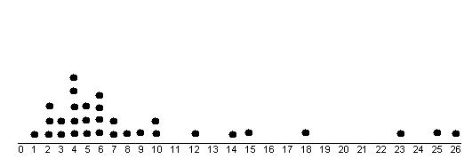
1.2: Displaying Quantitative Data with Graphs

Slide 2
Section 1.2
Displaying Quantitative Data with Graphs
After this section, you should be able to…
  CONSTRUCT and INTERPRET dotplots, stemplots, and histograms
  DESCRIBE the shape of a distribution
  COMPARE distributions
  USE histograms wisely

Slide 3

Dotplots
  One of the simplest graphs to construct and interpret is a dotplot. Each data value is shown as a dot above its location on a number line.
Number of Goals Scored Per Game by the 2004 US Women’s Soccer Team
3 | 0 | 2 | 7 | 8 | 2 | 4 | 3 | 5 | 1 | 1 | 4 | 5 | 3 | 1 | 1 | 3
3 | 3 | 2 | 1 | 2 | 2 | 2 | 4 | 3 | 5 | 6 | 1 | 5 | 5 | 1 | 1 | 5

Slide 4
How to Make a Dotplot
Draw a horizontal axis (a number line) and label it with the variable name.
Scale the axis from the minimum to the maximum value.
Mark a dot above the location on the horizontal axis corresponding to each data value.

Slide 5
Examining the Distribution of a Quantitative Variable
The purpose of a graph is to help us understand the data. After you make a graph, always ask, “What do I see?”
How to Examine the Distribution of a Quantitative Variable
In any graph, look for the overall pattern and for striking departures from that pattern.
Describe the overall pattern of a distribution by its:
  Shape
  Center
  Spread
Note individual values that fall outside the overall pattern. These departures are called outliers.
Don’t forget your SOCS!

Slide 6
Examine this data
Here is the estimated battery life for each of 9 different smart phones (in minutes) according to http://cell-phones.toptenreviews.com/smartphones/.
Displaying Quantitative Data
Smart Phone | Battery Life (minutes) Talk time
Apple iPhone 4 | 420
Motorola Atrix | 530
HTC Thunderbolt | 378
Samsung Infuse 4G | 480
T- Mobile G2X | 420
T – Mobile myTouch | 624
Samsung Galaxy | 390
Samsung Nexus | 360
HTC EVO 4G | 312
Xperia PLAY | 460
Describe the shape, center, and spread of the distribution. Are there any outliers?

Slide 7
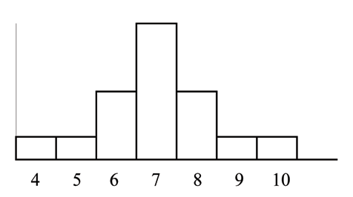
Describing Shape
  When you describe a distribution’s shape, concentrate on the main features. Look for rough symmetry or clear skewness.

Slide 8
Shape Definitions:
Symmetric: if the right and left sides of the graph are approximately mirror images of each other.
Skewed to the right (right-skewed) if the right side of the graph is much longer than the left side.
Skewed to the left (left-skewed) if the left side of the graph is much longer than the right side.
Symmetric
Skewed-left
Skewed-right

Slide 9
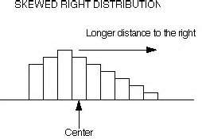

Slide 10
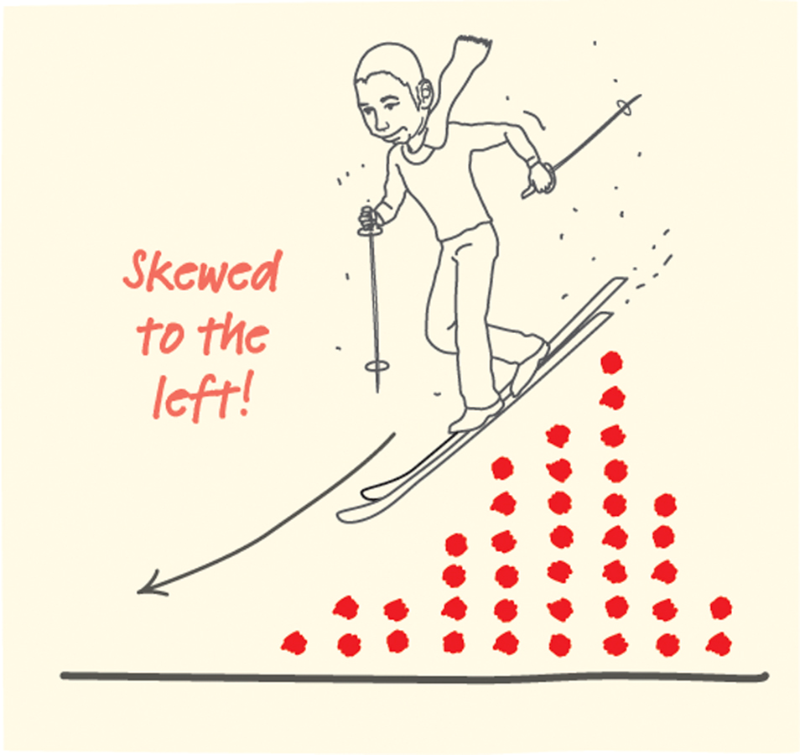

Slide 11
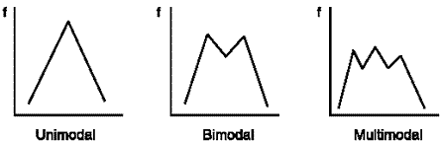
Other Ways to Describe Shape:
Unimodal
Bimodal
Multimodal

Slide 12
The first dotplot shows the outcomes of 100 rolls of a 10-sided die.
This distribution is roughly symmetric with no obvious modes. Don’t worry about the small differences in the number of dots for each die roll—this is bound to happen just by chance even if the frequencies should be the same. A distribution with this shape can be called “approximately uniform.”
The second dotplot shows the number of calories in one serving of whole wheat or multigrain bread.
This distribution is skewed to the left with a peak at 220 calories.

Slide 13
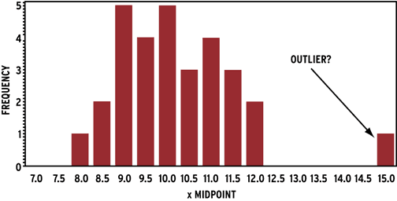
Outliers
Definition: Values that differ from the overall pattern are outliers.
We will learn specific ways to find outliers in a later chapter. For now, we can only identify “potential outliers.”

Slide 14
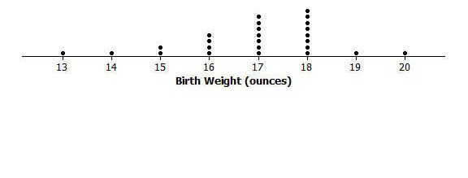
Center
We can describe the center by finding a value that divides the observations so that about half take larger values and about half take smaller values.
Ways to describe center:
Calculate median (best when distribution is skewed)
Calculate mean (best when distribution is symmetric)

Slide 15
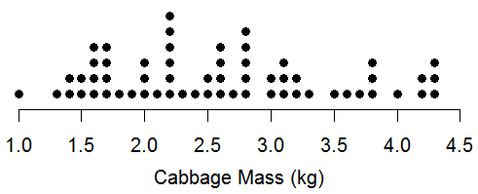
Spread
The spread of a distribution tells us how much variability there is in the data.
Ways to ‘describe’ spread:
Calculate the range
IQR (coming later)
Standard Deviation (coming later)

Slide 16
Below is a distribution of MPG achieved by various Honda vehicles. Describe the shape, center, and spread of the distribution. Are there any potential outliers? Remember to include CONTEXT!!!

Slide 17
Sample Answer:
Shape: The shape of the distribution is roughly unimodal and skewed left.
Center: The mean is 25.9 mpg and the median is 28 mpg. (only need one measure)
Spread: The range is 19 mpg.
Outliers: There are two potential outliers/influential values vehicles: 14 mpg and 18 mpg.

Slide 18
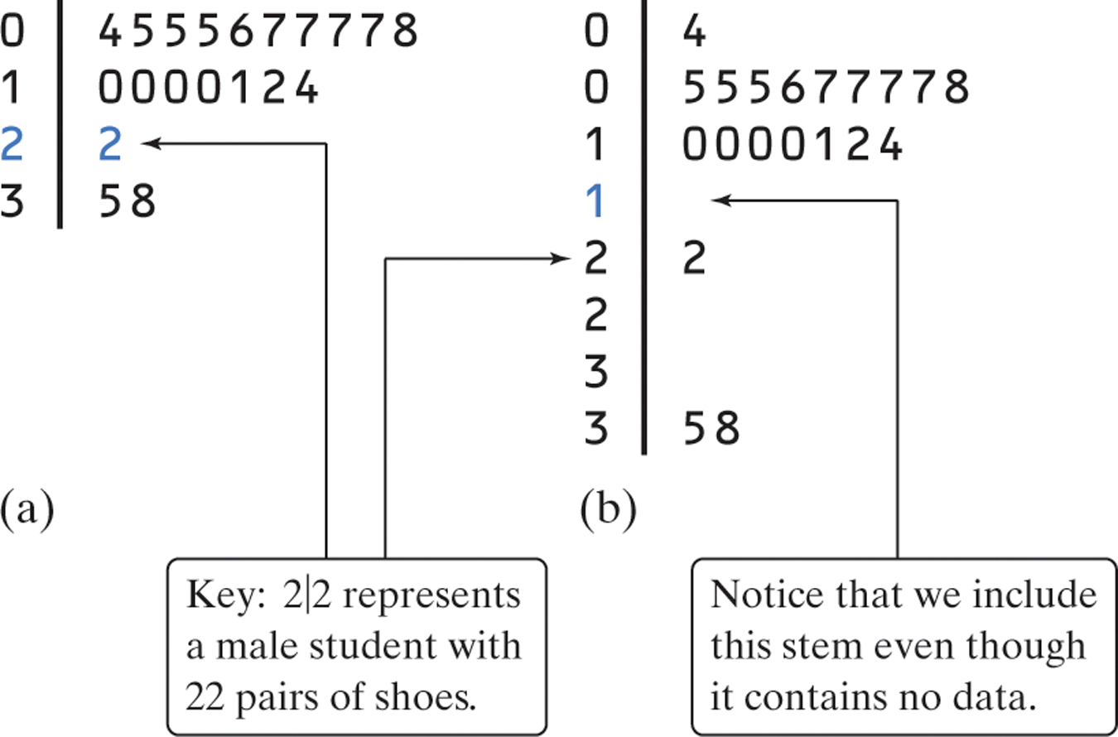
Stemplots (Stem-and-Leaf Plots)
Stemplots give us a quick picture of the distribution while including the actual numerical values.

Slide 19
How to Make a Stemplot
Separate each observation into a stem (all but the final digit) and a leaf (the final digit).
Write all possible stems from the smallest to the largest in a vertical column and draw a vertical line to the right of the column.
Write each leaf in the row to the right of its stem.
Arrange the leaves in increasing order out from the stem.
Provide a key that explains in context what the stems and leaves represent.

Slide 20
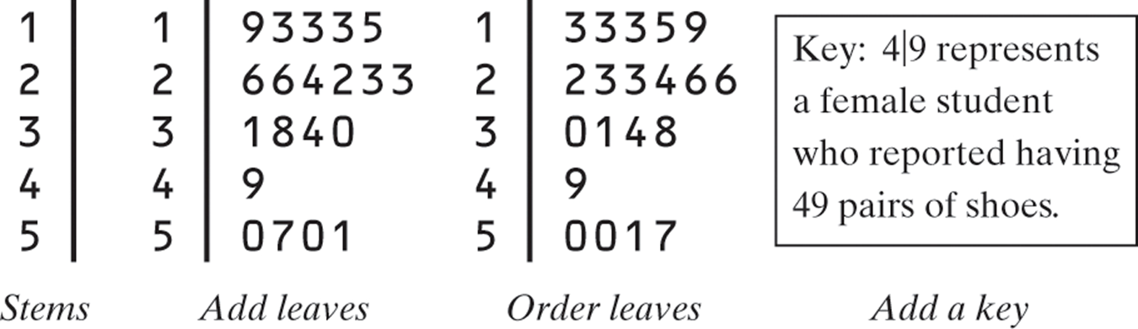
Stemplots (Stem-and-Leaf Plots)
These data represent the responses of 20 female AP Statistics students to the question, “How many pairs of shoes do you have?”
50 | 26 | 26 | 31 | 57 | 19 | 24 | 22 | 23 | 38
13 | 50 | 13 | 34 | 23 | 30 | 49 | 13 | 15 | 51

Slide 21
Two Special Types of Stem Plots
  Spilt Stemplots: Best when data values are “bunched up”
    Spilt 0-4 and 5-9
  Back-to-Back Stemplot: Compares two distributions of the same quantitative variable
Females
333
95
4332
66
410
8
9
100
7
Males
0 4
0 555677778
1 0000124
1
2 2
2
3
3 58
4
4
5
5
0
0
1
1
2
2
3
3
4
4
5
5
Back-to-Back
“split stems”
Key: 4|9 represents a student who reported having 49 pairs of shoes.

Slide 22
Histograms
  Quantitative variables often take many values.
  A graph of the distribution may be clearer if nearby values are grouped together.
  Most common graph of the distribution of one quantitative variable

Slide 23
How to Make a Histogram
Divide the range of data into classes of equal width.
Find the count (frequency) or percent (relative frequency) of individuals in each class.
Label and scale your axes and draw the histogram. The height of the bar equals its frequency. Adjacent bars should touch, unless a class contains no individuals.

Slide 24
Making a Histogram
Frequency Table
Class | Count
0 to <5 | 20
5 to <10 | 13
10 to <15 | 9
15 to <20 | 5
20 to <25 | 2
25 to <30 | 1
Total | 50
Number of States
Percent of foreign-born residents

Slide 25
Team | PPG | Team | PPG | Team | PPG
Hawks | 101.7 | Pacers | 100.8 | Thunder | 101.5
Celtics | 99.2 | Clippers | 95.7 | Magic | 102.8
Bobcats | 95.3 | Lakers | 101.7 | 76ers | 97.7
Bulls | 97.5 | Grizzlies | 102.5 | Suns | 110.2
Cavaliers | 102.1 | Heat | 96.5 | Portland Trail Blazers | 98.1
Mavericks | 102 | Bucks | 97.7 | Kings | 100
Nuggets | 106.5 | Timberwolves | 98.2 | Spurs | 101.4
Pistons | 94 | Nets | 92.4 | Raptors | 104.1
Warriors | 108.8 | Hornets | 100.2 | Jazz | 104.2
Rockets | 102.4 | Knicks | 102.1 | Wizards | 96.2
The table presents the average points scored per game (PTSG) for the 30 NBA teams in the 2009-2010 regular season.
Notes:
Since the smallest value is 92.4 and the largest value is 110.2, we choose classes from 90 to <95, 95 to <100, 100 to <105, 105 to <110, and 110 to <115. Here are a frequency histogram and a relative frequency histogram for these data. The relative frequency histogram looks exactly the same except for the vertical scale.

Slide 26
Caution: Using Histograms Wisely
Don’t confuse histograms and bar graphs.
Don’t use counts (in a frequency table) or percents (in a relative frequency table) as data.
Use percents instead of counts on the vertical axis when comparing distributions with different numbers of observations.
Just because a graph looks nice, it’s not necessarily a meaningful display of data.

Slide 27
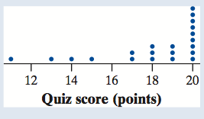
Check Your Understanding
The dotplot displays the
scores of 21 statistics
students on a 20-point quiz.
What percentage of students scored higher than 16 points?
b. Describe the shape of the distribution.
c. Are there any potential outliers? Why?

Slide 28
Check Your Understanding
The dotplot displays the
scores of 21 statistics
students on a 20-point quiz.
What percentage of students scored higher than 16 points?
17/21 or 80.95%
b. Describe the shape of the distribution.
Skewed left.
Are there any potential outliers? Why?
Yes, the student scoring approximately 10 is an outlier. He/she preformed much worse than the rest of the class.

Slide 29
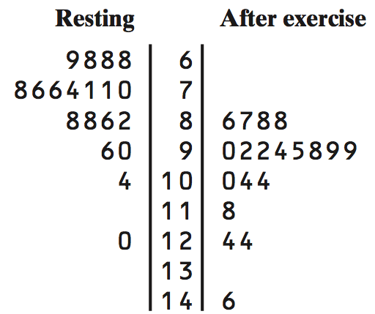
Check Your Understanding
Here is a back-to-back stemplot of 19 middle school students’ resting pulse rates and their pulse rates after 5 minutes of running.
Write a few sentences comparing the distributions of resting and after exercise pulse rates.

Slide 30
Check Your Understanding
The resting and after exercise pulse rates are both skewed to the left.
The median for resting pulse is lower at 76 beats compared to a median of 98 beats after exercise.
The variabilities are fairly similar; resting range is 52 beats and after exercise is 60 beats.
There is one potential outlier in both distributions: 120 beats (resting) and 146 beats (after exercise).

