Slide 1
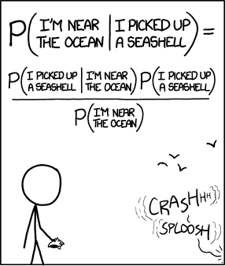
5.3: Conditional Probability and Independence

Slide 2
After this section, you should be able to…
DEFINE conditional probability
COMPUTE conditional probabilities
DESCRIBE chance behavior with a tree diagram
DEFINE independent events
DETERMINE whether two events are independent
APPLY the general multiplication rule to solve probability questions

Slide 3
Basic Probability
Assume a spinner has 8 equal sized sections; each section is numbered a unique number from 1 to 8.
What is the probability of getting an even number?
What is the probability of getting a prime number?
What is the probability of getting a multiple of 3?

Slide 4
Basic Probability
Assume a spinner has 8 equal sized sections; each section is numbered a unique number from 1 to 8.
What is the probability of getting an even number? 4/8 or 1/2
What is the probability of getting a prime number? 5/8
What is the probability of getting a multiple of 3? 2/8 or 1/4

Slide 5
Mixed Probability
Assume a spinner has 8 equal sized sections; each section is numbered a unique number from 1 to 8.
What is the probability of getting 2 even spins in a row?
What is the probability of getting a prime number or an odd number?
What is the probability of getting a multiple of 3 or an even spin?

Slide 6
Mixed Probability
Assume a spinner has 8 equal sized sections; each section is numbered a unique number from 1 to 8.
What is the probability of getting 2 even spins in a row? 1/4
What is the probability of getting a prime number or an odd number? 5/8
What is the probability of getting a multiple of 3 or an even spin? 5/8

Slide 7
What is Conditional Probability?
When we are trying to find the probability that one event will happen under the condition that some other event is already known to have occurred, we are trying to determine a conditional probability.
The probability that one event happens given that another event is already known to have happened is called a conditional probability. Suppose we know that event A has happened. Then the probability that event B happens given that event A has happened is denoted by P(B | A).
Read | as “given that” or “under the condition that”

Slide 8
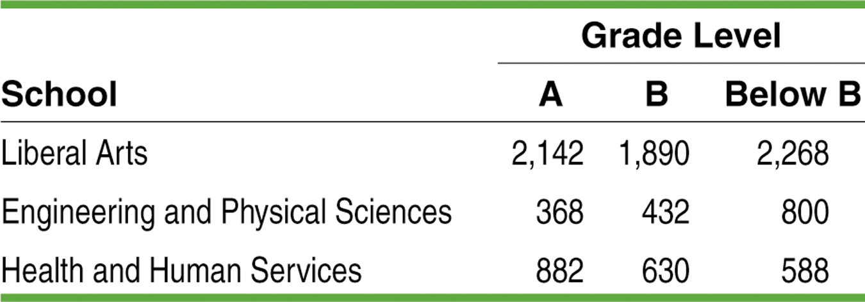
Example: Grade Distributions
E: the grade comes from an EPS course, and
L: the grade is lower than a B.
Total
6300
1600
2100
Total 3392 2952 3656 10000
Find P(L)
Find P(E | L)
Find P(L | E)
P(L) = 3656 / 10000 = 0.3656
P(E | L) = 800 / 3656 = 0.2188
P(L| E) = 800 / 1600 = 0.5000

Slide 9
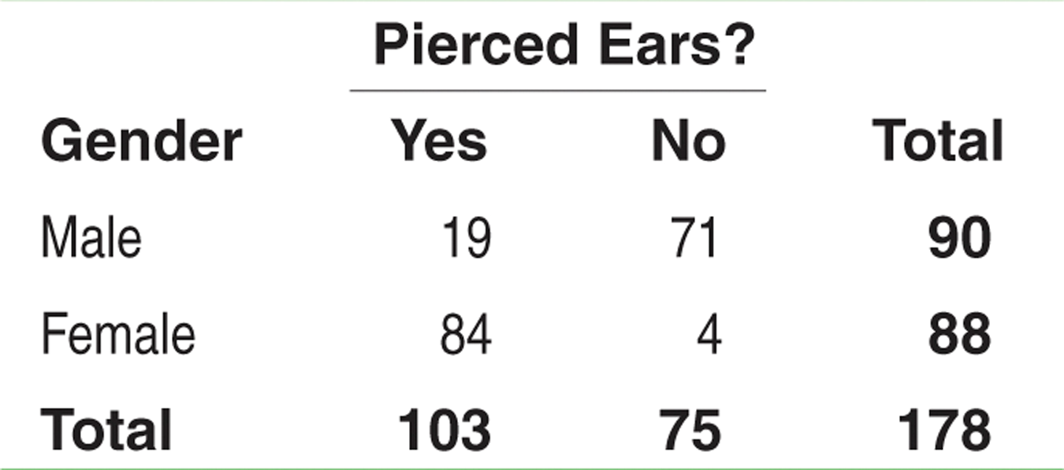
Calculate the following conditional probabilities:
P $\left(Yes | Male\right)$
P$\left(No | Female\right)$
P $\left(Female | Yes\right)$

Slide 10
Calculate the following conditional probabilities:
P $\left(Yes | Male\right)$= 19/90
P$\left(No | Female\right)$ = 4/88
P $\left(Female | Yes\right)$ = 84/103

Slide 11
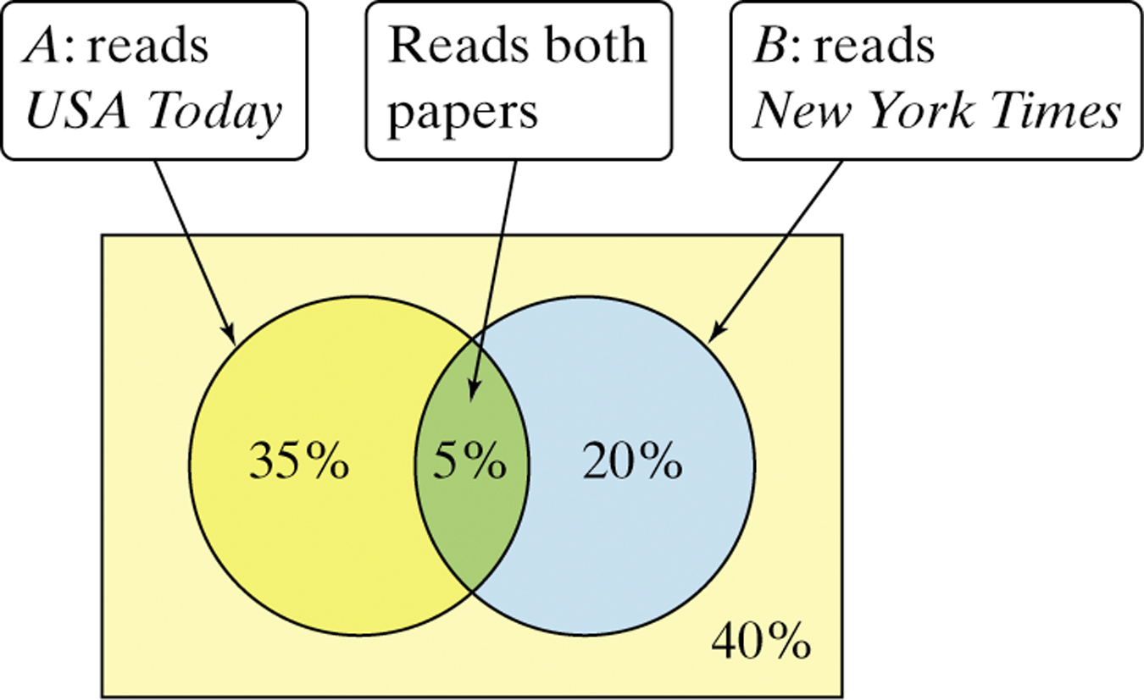
Who Reads the Newspaper?
Residents of a large apartment complex can be classified based on the events A: reads USA Today and B: reads the New York Times. What is the probability that a randomly selected resident who reads USA Today also reads the New York Times?

Slide 12
Who Reads the Newspaper?
Residents of a large apartment complex can be classified based on the events A: reads USA Today and B: reads the New York Times. What is the probability that a randomly selected resident who reads USA Today also reads the New York Times?
There is a 12.5% chance that a randomly selected resident who reads USA Today also reads the New York Times.

Slide 13
Conditional Probability and Independence
When knowledge that one event has happened does not change the likelihood that another event will happen, we say the two events are independent.
Two events A and B are independent if the occurrence of one event has no effect on the chance that the other event will happen. In other words, events A and B are independent if:
P(A | B) = P(A)
OR
P(B | A) = P(B).

Slide 14
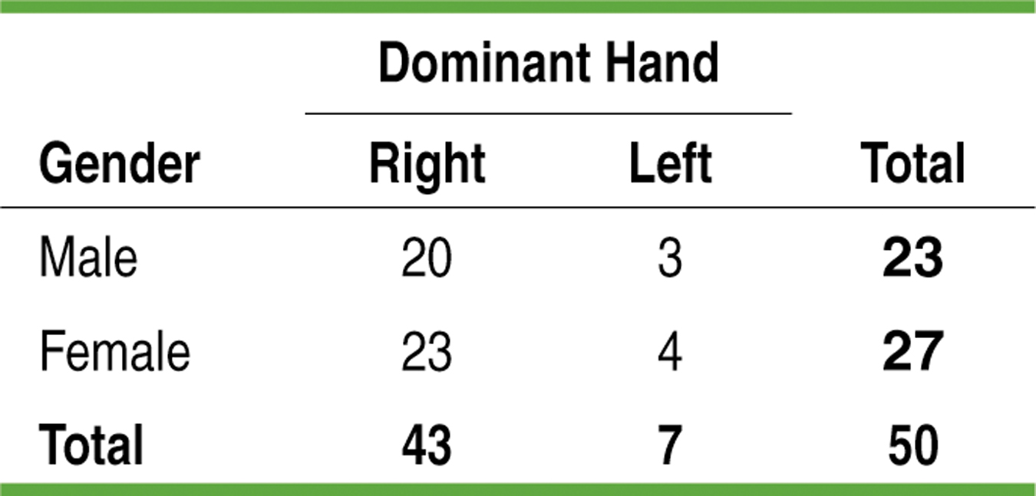
Conditional Probability and Independence
P(A | B) = P(A)
OR
P(B | A) = P(B).
Are the events “male” and “left-handed” independent?
A: left-handed
B: male

Slide 15
Conditional Probability and Independence
P(A | B) = P(A)
OR
P(B | A) = P(B).
Are the events “male” and “left-handed” independent?.
A: left-handed
B: male
P(left-handed | male) = 3/23 = 0.13
P(left-handed) = 7/50 = 0.14

Slide 16
Are these events independent?
Junior and AP Calc?
Senior and AP Stats?
 | Earns A in AP Stats | Earns A in AP Calc | Total
Junior | 5 | 7 | 12
Senior | 12 | 9 | 21
Total | 17 | 16 | 33

Slide 17
Are these events independent?
Junior and AP Calc?
P $\left(Junior | AP Calc\right)$ = 7/16 ; P(Junior)= 12/33
Since the values are not equal, the events are not independent.
Senior and AP Stats?
P (Senior│𝐴𝑃 Stats) = 12/17 ; P(Senior)= 21/33
Since the values are not equal, the events are not independent.
 | Earns A in AP Stats | Earns A in AP Calc | Total
Junior | 5 | 7 | 12
Senior | 12 | 9 | 21
Total | 17 | 16 | 33

Slide 18
General Multiplication Rule
The probability that events A and B both occur can be found using the general multiplication rule
P(A ∩ B) = P(A) • P(B | A)
where P(B | A) is the conditional probability that event B occurs given that event A has already occurred.

Slide 19
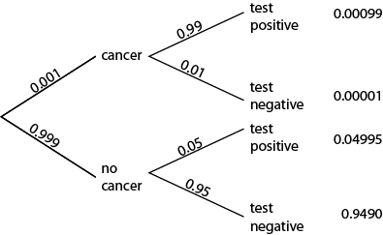
Tree Diagrams
Tree Diagrams are best for events that follow each other, events that happen multiple times or events that are logically related (example: graduate high school first, then attend college OR having cancer, then testing positive).

Slide 20
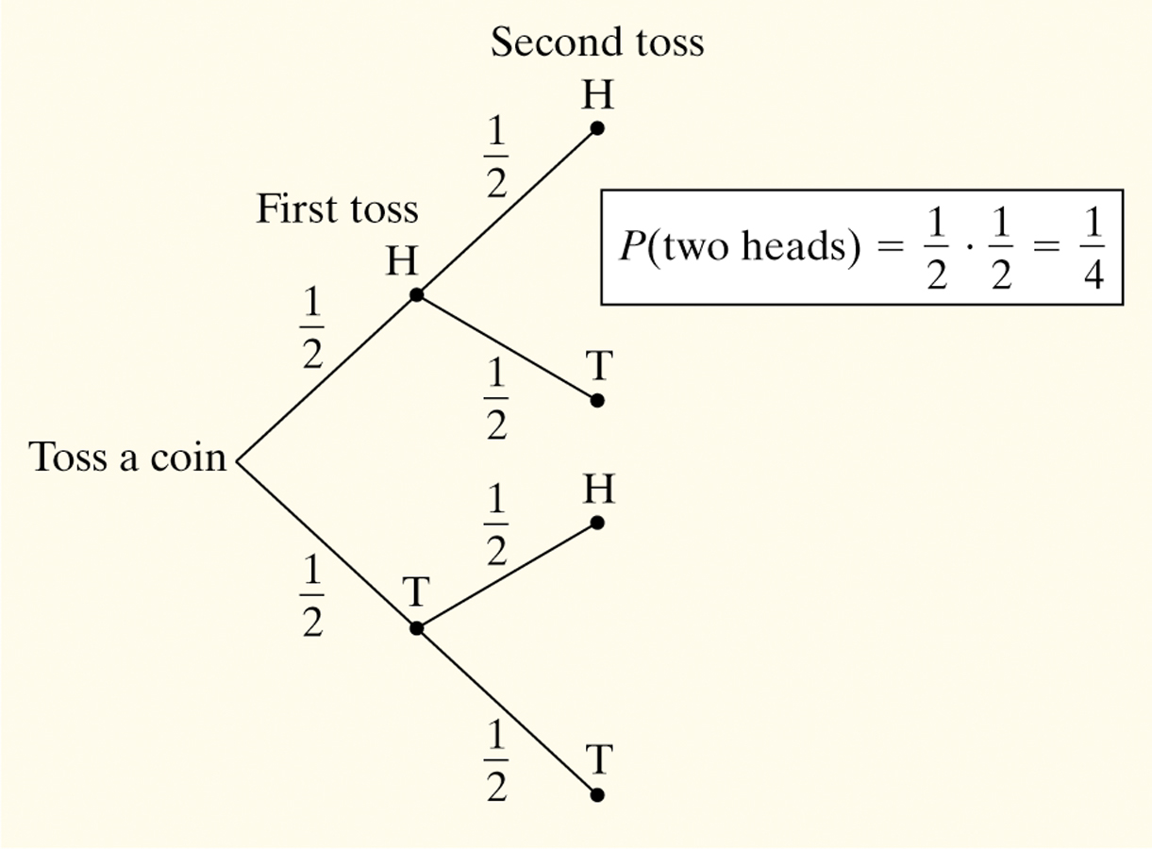
Tree Diagrams
Consider flipping a coin twice.
What is the probability of getting two heads?
Sample Space:
HH HT TH TT
So, P(two heads) = P(HH) = 1/4

Slide 21
Example: Teens with Online Profiles
The Pew Internet and American Life Project finds that 93% of teenagers (ages 12 to 17) use the Internet, and that 55% of online teens have a Facebook profile.
What percent of teens are online and have a Facebook profile?

Slide 22
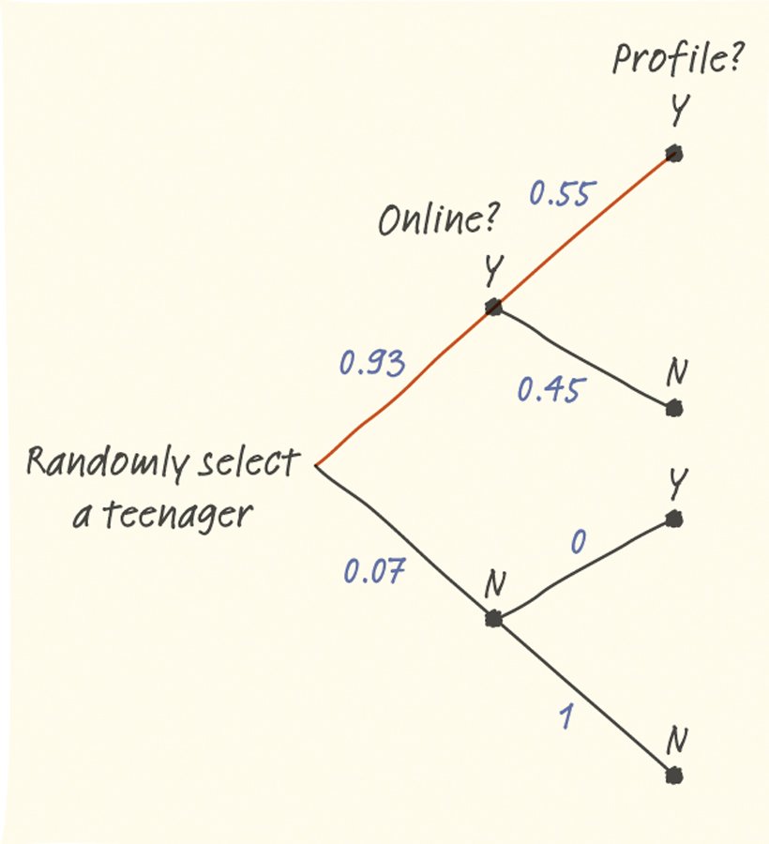
Example: Teens with Online Profiles
The Pew Internet and American Life Project finds that 93% of teenagers (ages 12 to 17) use the Internet, and that 55% of online teens have a Facebook profile.
What percent of teens are online and have a Facebook profile?
51.15% of teens are online and have posted a profile.

Slide 23
Consecutive Probability
Assume a spinner has 8 equal sized sections; each section is numbered a unique number from 1 to 8. You spin the spinner three times.
What is the probability of getting at least two even spins?
What is the probability of getting a prime number exactly twice?
What is the probability of getting a multiple of 3 or an even spin only once?

Slide 24
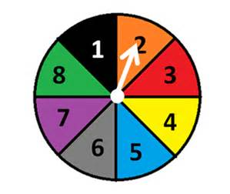

Slide 25
Internet & YouTube Usage
About 27% of adult Internet users are 18 to 29 years old, another 45% are 30 to 49 years old, and the remaining 28% are 50 and over.
The Pew Internet and American Life Project finds that 70% of Internet users aged 18 to 29 have visited a video-sharing site, along with 51% of those aged 30 to 49 and 26% of those 50 or older.
Make a Tree Diagram of the probabilities.
Questions on next slide.

Slide 26
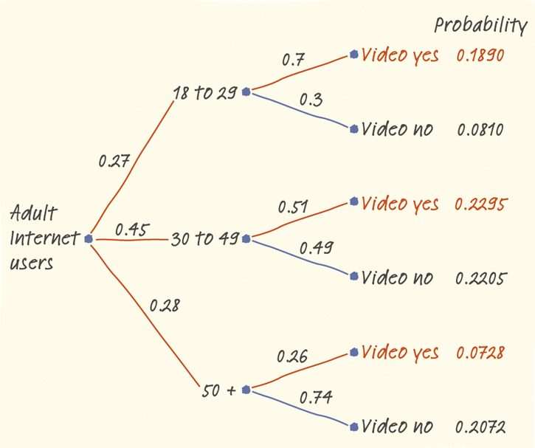

Slide 27
B. What proportion of adults are 18 to 29 year old Internet users that visit video-sharing sites?
C. What proportion of adults are 30 to 49 year old Internet users that visit video-sharing sites?
D. What proportion of adults are 50 and over year old Internet users that visit video-sharing sites?
E. What proportion of all adult Internet users visit video-sharing sites? Do most Internet users visit YouTube and/or similar sites? Justify your answer.

Slide 28
B. What proportion of adults are 18 to 29 year old Internet users that visit video-sharing sites?
.27 x .7 = .189
C. What proportion of adults are 30 to 49 year old Internet users that visit video-sharing sites?
.45 x .51 = .2295
D. What proportion of adults are 50 and over year old Internet users that visit video-sharing sites?
.28 x 26 = .0728

Slide 29
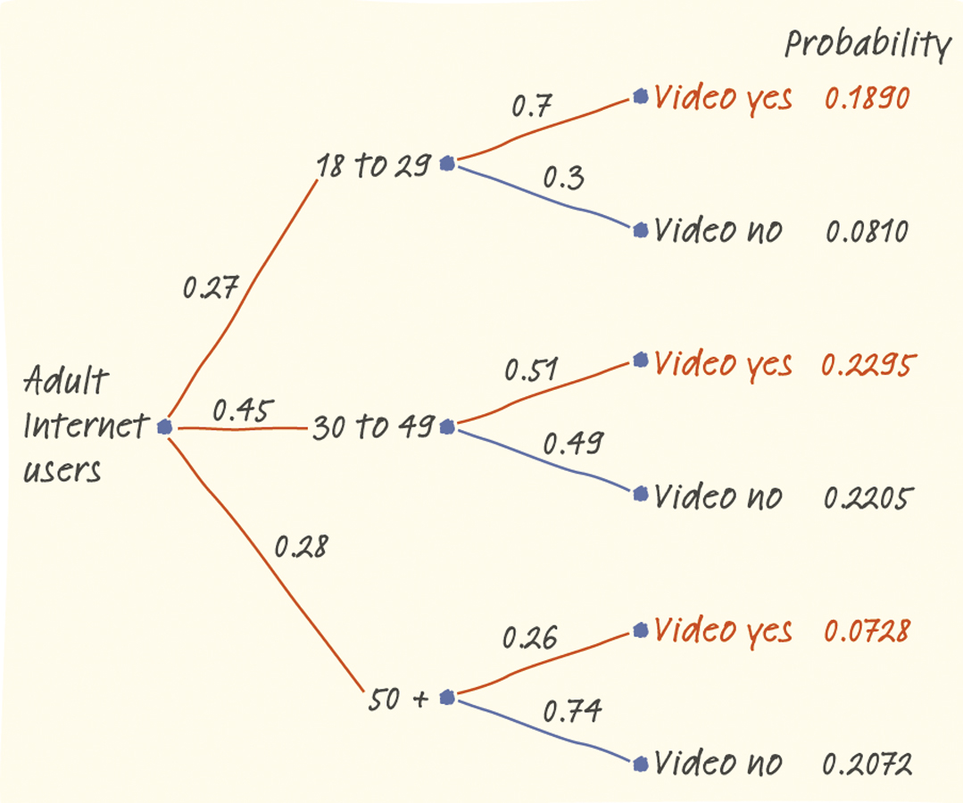
E.
P(video yes ∩ 18 to 29) = 0.27 • 0.7
=0.1890
P(video yes ∩ 30 to 49) = 0.45 • 0.51
=0.2295
P(video yes ∩ 50 +) = 0.28 • 0.26
=0.0728

Slide 30
P(video yes) = 0.1890 + 0.2295 + 0.0728 = 0.4913
49.13% of all adult Americans that use the Internet watch videos online. While 49.13% represents a large proportion of the population, it is not a majority, so it is not fair to say “most” adult American Internet users visit video-sharing sites.

Slide 31
Special Probability Rules

Slide 32
Independence: A Special Multiplication Rule
When events A and B are independent, we can simplify the general multiplication rule since P(B| A) = P(B).
Multiplication rule for independent events
If A and B are independent events, then the probability that A and B both occur is
P(A ∩ B) = P(A) • P(B)
Example:
Following the Space Shuttle Challenger disaster, it was determined that the failure of O-ring joints in the shuttle’s booster rockets was to blame. Under cold conditions, it was estimated that the probability that an individual O-ring joint would function properly was 0.977. Assuming O-ring joints succeed or fail independently, what is the probability all six would function properly?
P(joint1 OK and joint 2 OK and joint 3 OK and joint 4 OK and joint 5 OK and joint 6 OK)
=P(joint 1 OK) • P(joint 2 OK) • … • P(joint 6 OK)
=(0.977)(0.977)(0.977)(0.977)(0.977)(0.977) = 0.87

Slide 33
