Slide 1
6.1: Discrete and Continuous Random Variables

Slide 2
Section 6.1 Discrete & Continuous Random Variables
After this section, you should be able to…
APPLY the concept of discrete random variables to a variety of statistical settings
CALCULATE and INTERPRET the mean (expected value) of a discrete random variable
CALCULATE and INTERPRET the standard deviation (and variance) of a discrete random variable
DESCRIBE continuous random variables

Slide 3
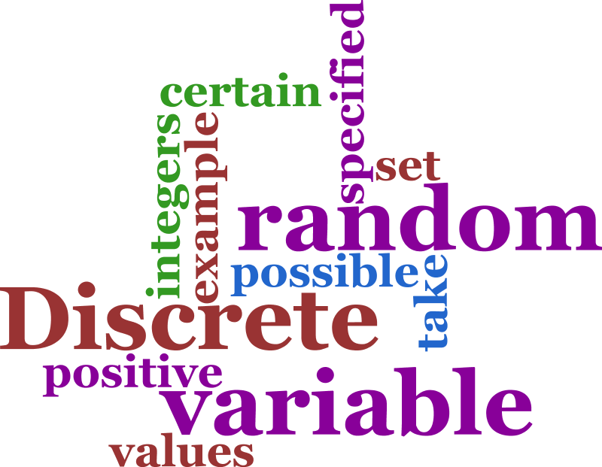
Random Variables
A random variable, usually written as X, is a variable whose possible values are numerical outcomes of a random phenomenon.
There are two types of random variables, discrete random variables and continuous random variables.

Slide 4
Discrete Random Variables
A discrete random variable is one which may take on only a countable number of distinct values such as 0, 1, 2, 3, 4,....
Discrete random variables are usually (but not necessarily) counts.
Examples:
number of children in a family
the Friday night attendance at a cinema
the number of patients a doctor sees in one day
the number of defective light bulbs in a box of ten
the number of “heads” flipped in 3 trials

Slide 5
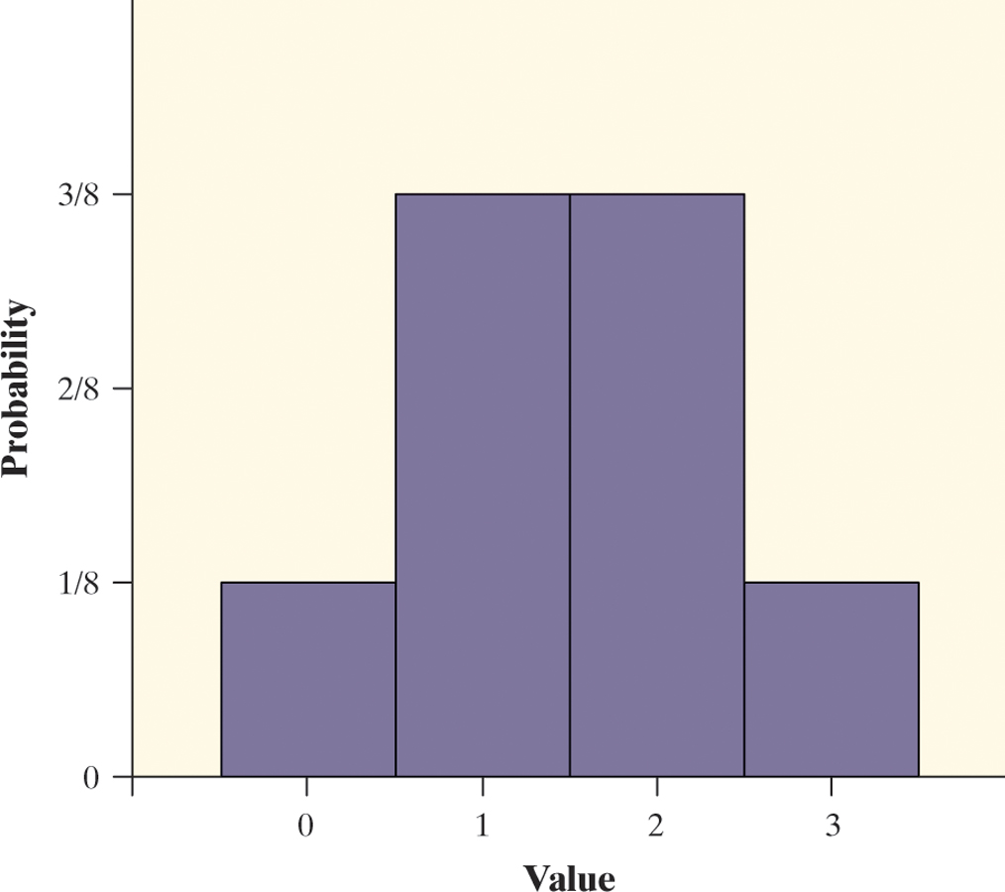
Probability Distribution
The probability distribution of a discrete random variable is a list of probabilities associated with each of its possible values
Consider tossing a fair coin 3 times.
Define X = the number of heads obtained
X = 0: TTT
X = 1: HTT THT TTH
X = 2: HHT HTH THH
X = 3: HHH
Value | 0 | 1 | 2 | 3
Probability | 1/8 | 3/8 | 3/8 | 1/8

Slide 6
Rolling Dice: Probability Distribution
Roll your pair of dice 20 times, record the sum for each trial.

Slide 7
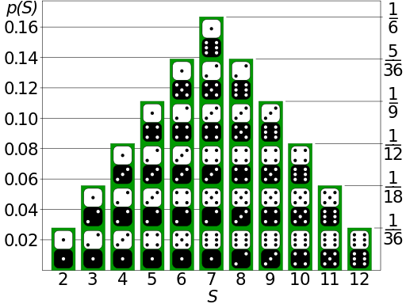

Slide 8
Discrete Random Variables
A discrete random variable X takes a fixed set of possible values with gaps between. The probability distribution of a discrete random variable X lists the values x_{i} and their probabilities p_{i}:
Value: x₁ x₂ x₃ …
Probability: p₁ p₂ p₃ …
The probabilities p_{i} must satisfy two requirements:
Every probability p_{i} is a number between 0 and 1.
The sum of the probabilities is 1.
To find the probability of any event, add the probabilities p_{i} of the particular values x_{i} that make up the event.

Slide 9
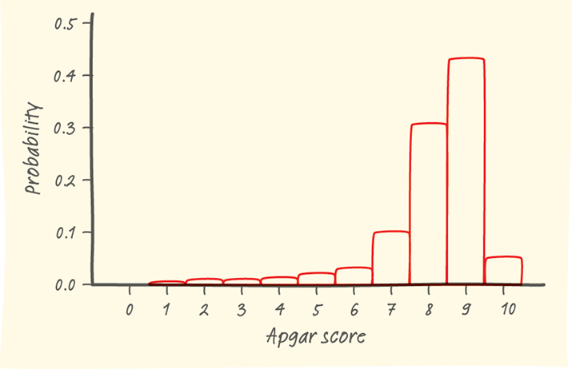
Describing the (Probability) Distribution
When analyzing discrete random variables, we’ll follow the same strategy we used with quantitative data – describe the shape, center (mean), and spread (standard deviation), and identify any outliers.

Slide 10
Example: Babies’ Health at Birth
Background details are on page 343.
Show that the probability distribution for X is legitimate.
Make a histogram of the probability distribution. Describe what you see.
Apgar scores of 7 or higher indicate a healthy baby. What is P(X ≥ 7)?
Value: | 0 | 1 | 2 | 3 | 4 | 5 | 6 | 7 | 8 | 9 | 10
Probability: | 0.001 | 0.006 | 0.007 | 0.008 | 0.012 | 0.020 | 0.038 | 0.099 | 0.319 | 0.437 | 0.053

Slide 11
Example: Babies’ Health at Birth
Background details are on page 343.
Show that the probability distribution for X is legitimate.
Make a histogram of the probability distribution. Describe the distribution.
Apgar scores of 7 or higher indicate a healthy baby. What is P(X ≥ 7)?
Value: | 0 | 1 | 2 | 3 | 4 | 5 | 6 | 7 | 8 | 9 | 10
Probability: | 0.001 | 0.006 | 0.007 | 0.008 | 0.012 | 0.020 | 0.038 | 0.099 | 0.319 | 0.437 | 0.053
(a) All probabilities are between 0 and 1 and the probabilities sum to 1. This is a legitimate probability distribution.

Slide 12
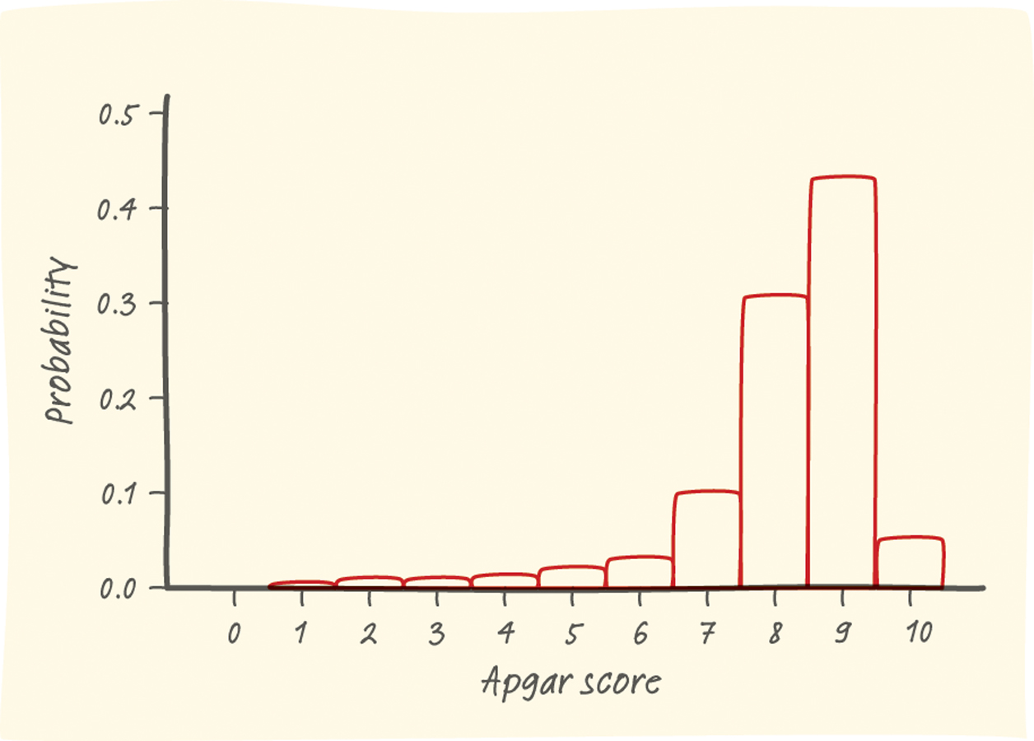
Example: Babies’ Health at Birth
b. Make a histogram of the probability distribution. Describe what you see.
c. Apgar scores of 7 or higher indicate a healthy baby. What is P(X ≥ 7)?
Value: | 0 | 1 | 2 | 3 | 4 | 5 | 6 | 7 | 8 | 9 | 10
Probability: | 0.001 | 0.006 | 0.007 | 0.008 | 0.012 | 0.020 | 0.038 | 0.099 | 0.319 | 0.437 | 0.053
(c) P(X ≥ 7) = .908
We’d have a 91 % chance of randomly choosing a healthy baby.
(b) The left-skewed shape of the distribution suggests a randomly selected newborn will have an Apgar score at the high end of the scale. While the range is from 0 to 10, there is a VERY small chance of getting a baby with a score of 5 or lower. There are no obvious outliers. The center of the distribution is approximately 8.

Slide 13
Mean of a Discrete Random Variable
The mean of any discrete random variable is an average of the possible outcomes, with each outcome weighted by its probability.
Suppose that X is a discrete random variable whose probability distribution is
Value: x₁ x₂ x₃ …
Probability: p₁ p₂ p₃ …
To find the mean (expected value) of X, multiply each possible value by its probability, then add all the products:

Slide 14
Example: Apgar Scores – What’s Typical?
Consider the random variable X = Apgar Score
Compute the mean of the random variable X and interpret it in context.
Value: | 0 | 1 | 2 | 3 | 4 | 5 | 6 | 7 | 8 | 9 | 10
Probability: | 0.001 | 0.006 | 0.007 | 0.008 | 0.012 | 0.020 | 0.038 | 0.099 | 0.319 | 0.437 | 0.053

Slide 15
Example: Apgar Scores – What’s Typical?
Consider the random variable X = Apgar Score
Compute the mean of the random variable X and interpret it in context.
Value: | 0 | 1 | 2 | 3 | 4 | 5 | 6 | 7 | 8 | 9 | 10
Probability: | 0.001 | 0.006 | 0.007 | 0.008 | 0.012 | 0.020 | 0.038 | 0.099 | 0.319 | 0.437 | 0.053
The mean Apgar score of a randomly selected newborn is 8.128. This is the long-term average Agar score of many, many randomly chosen babies.
Note: The expected value does not need to be a possible value of X or an integer! It is a long-term average over many repetitions.

Slide 16
Analyzing Discrete Random Variables on the Calculator
1. Using one-variable statistics to calculate:
2. Enter “X” for L1 and “frequency” for L2.
3. Calculate 1 Var-Stat L1, L2
Click the following link:
TI-84 Instructions

Slide 17
Calculate the Mean (Expected Value)
Value |  | 5 | 6 | 7 | 8 | 9 | 10
Probability |  | 0.08 | 0.12 | 0.30 | 0.22 | 0.20 | 0.08

Slide 18
Standard Deviation of a Discrete Random Variable
The definition of the variance of a random variable is similar to the definition of the variance for a set of quantitative data. To get the standard deviation of a random variable, take the square root of the variance.
Suppose that X is a discrete random variable whose probability distribution is
Value: x₁ x₂ x₃ …
Probability: p₁ p₂ p₃ …
and that µ_{X} is the mean of X. The variance of X is

Slide 19
Example: Apgar Scores – How Variable Are They?
Consider the random variable X = Apgar Score
Compute the standard deviation of the random variable X and interpret it in context.
Value: | 0 | 1 | 2 | 3 | 4 | 5 | 6 | 7 | 8 | 9 | 10
Probability: | 0.001 | 0.006 | 0.007 | 0.008 | 0.012 | 0.020 | 0.038 | 0.099 | 0.319 | 0.437 | 0.053
Variance
The standard deviation of X is 1.437. On average, a randomly selected baby’s Apgar score will differ from the mean 8.128 by about 1.4 units.

Slide 20
Continuous Random Variable
A continuous random variable is one which takes an infinite number of possible values.
Continuous random variables are usually measurements.
Examples:
height
weight
the amount of sugar in an orange
the time required to run a mile.

Slide 21
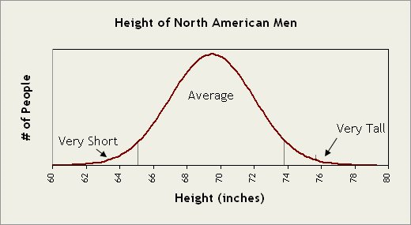
Continuous Random Variables
A continuous random variable X takes on all values in an interval of numbers. The probability distribution of X is described by a density curve. The probability of any event is the area under the density curve and above the values of X that make up the event.

Slide 22
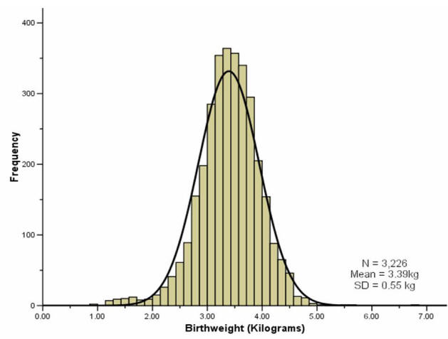
Continuous Random Variables
A continuous random variable is not defined at specific values.
Instead, it is defined over an interval of value; however, you can calculate the probability of a range of values.
It is very similar to z-scores and normal distribution calculations.

Slide 23
Example: Young Women’s Heights
The height of young women can be defined as a continuous random variable (Y) with a probability distribution is N(64, 2.7).
A. What is the probability that a randomly chosen young woman has height between 68 and 70 inches?
P(68 ≤ Y ≤ 70) = ???

Slide 24
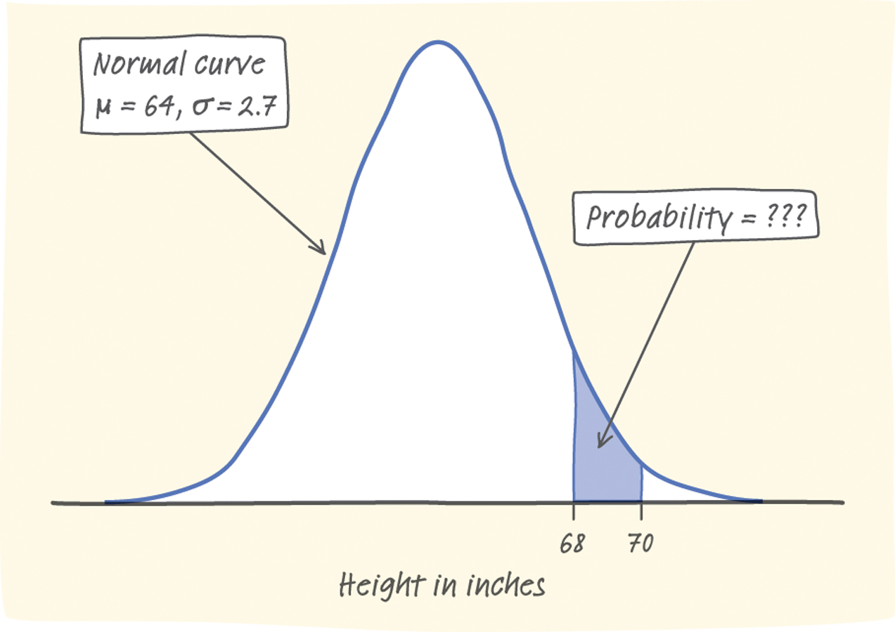
Example: Young Women’s Heights
The height of young women can be defined as a continuous random variable (Y) with a probability distribution is N(64, 2.7).
A. What is the probability that a randomly chosen young woman has height between 68 and 70 inches?
P(68 ≤ Y ≤ 70) = ???
P(1.48 ≤ Z ≤ 2.22) = P(Z ≤ 2.22) – P(Z ≤ 1.48)
= 0.9868 – 0.9306
= 0.0562
There is about a 5.6% chance that a randomly chosen young woman has a height between 68 and 70 inches.

Slide 25
Example: Young Women’s Heights
The height of young women can be defined as a continuous random variable (Y) with a probability distribution is N(64, 2.7).
B. At 70 inches tall, is Ms. Young unusually tall?

Slide 26
Example: Young Women’s Heights
The height of young women can be defined as a continuous random variable (Y) with a probability distribution is N(64, 2.7).
B. At 70 inches tall, is Ms. Young unusually tall?
P(Y ≤ 70) = ???
P value: 0.9868
Yes, Ms. Young is unusually tall because 98.68% of the population is shorter than her.

