Slide 1
6.2: Transforming and Combining Random Variables

Slide 2
After this section, you should be able to…
DESCRIBE the effect of performing a linear transformation on a random variable
COMBINE random variables and CALCULATE the resulting mean and standard deviation
CALCULATE and INTERPRET probabilities involving combinations of Normal random variables

Slide 3
Linear Transformations on Random Variables

Slide 4
Review: Linear Transformations
In Chapter 2, we studied the effects of linear transformations on the shape, center, and spread of a distribution of data. Remember:
Adding (or subtracting) a constant, a, to each observation:
Adds a to measures of center and location.
Does not change the shape or measures of spread.
Multiplying (or dividing) each observation by a constant, b:
Multiplies (divides) measures of center and location by b.
Multiplies (divides) measures of spread by |b|.
Does not change the shape of the distribution.

Slide 5
Linear Transformations on Random Variables
Multiplying (or dividing) each value of a random variable by a number b:
Multiplies (divides) measures of center and location (mean, median, quartiles, percentiles) by b.
Multiplies (divides) measures of spread (range, IQR, standard deviation) by |b|.
Does not change the shape of the distribution.
Note: Multiplying a random variable by a constant b multiplies the variance by b².

Slide 6
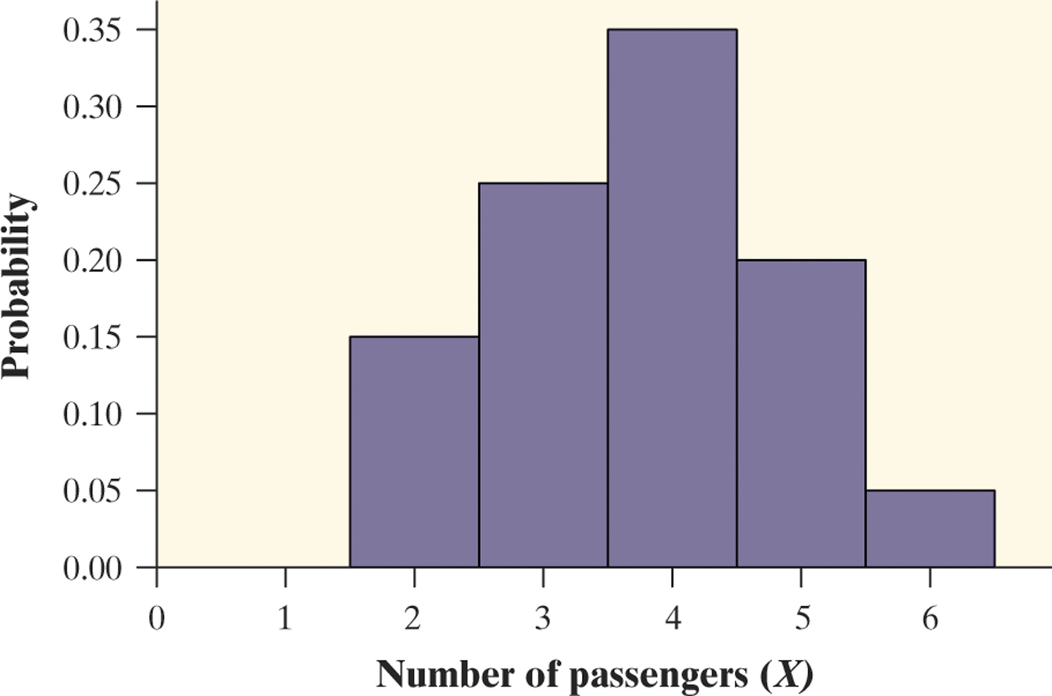
Linear Transformations
Pete’s Jeep Tours offers a popular half-day trip in a tourist area. There must be at least 2 passengers for the trip to run, and the vehicle will hold up to 6 passengers. Define X as the number of passengers on a randomly selected day.
Passengers x_{i} | 2 | 3 | 4 | 5 | 6
Probability p_{i} | 0.15 | 0.25 | 0.35 | 0.20 | 0.05
The mean of X is 3.75 and the standard deviation is 1.090.

Slide 7
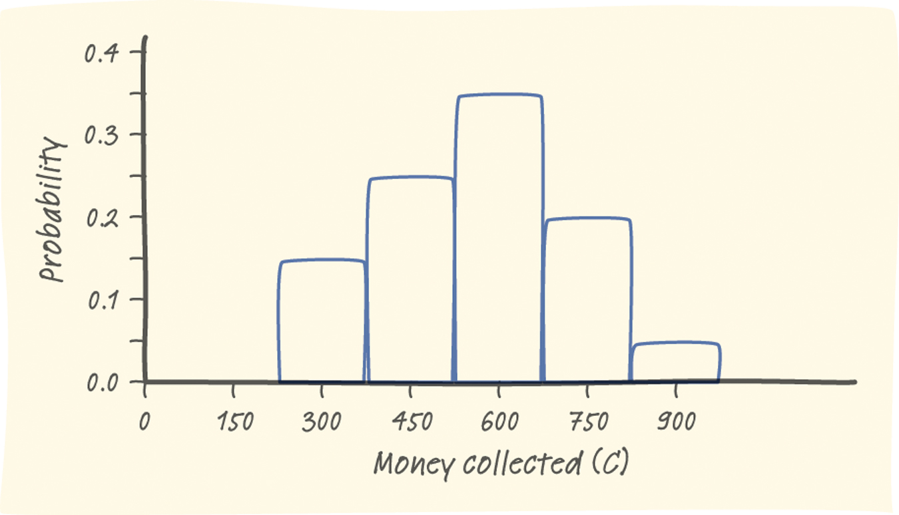
Linear Transformations
Pete charges $150 per passenger. The random variable C describes the amount Pete collects on a randomly selected day.
Collected c_{i} | 300 | 450 | 600 | 750 | 900
Probability p_{i} | 0.15 | 0.25 | 0.35 | 0.20 | 0.05
The mean of C is $562.50 and the standard deviation is $163.50.

Slide 8
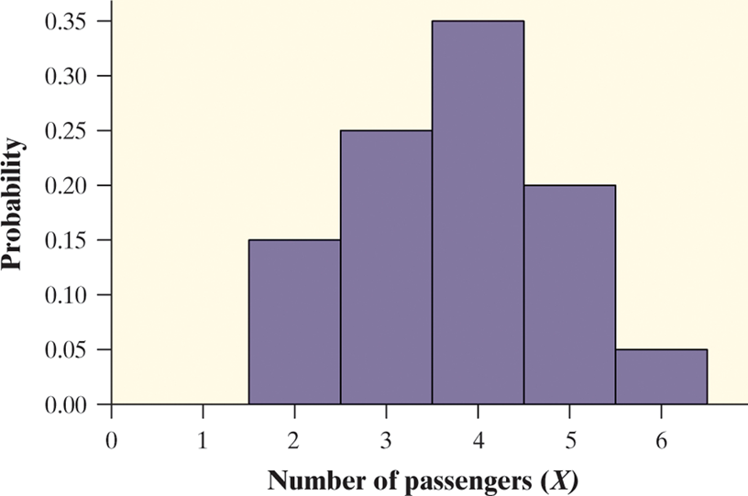
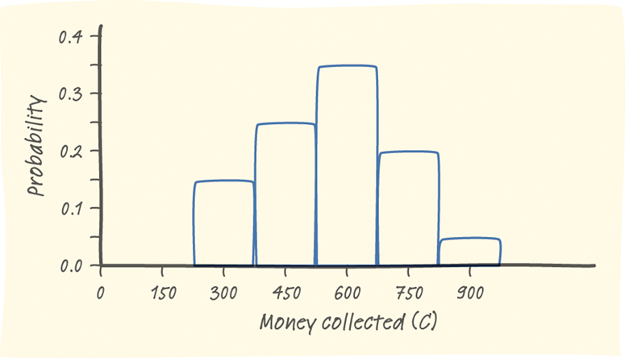
Compare the shape, center and spread of each distribution.

Slide 9
Linear Transformations on Random Variables
Adding the same number a (which could be negative) to each value of a random variable:
Adds a to measures of center and location (mean, median, quartiles, percentiles).
Does not change measures of spread (range, IQR, standard deviation).
Does not change the shape of the distribution.

Slide 10
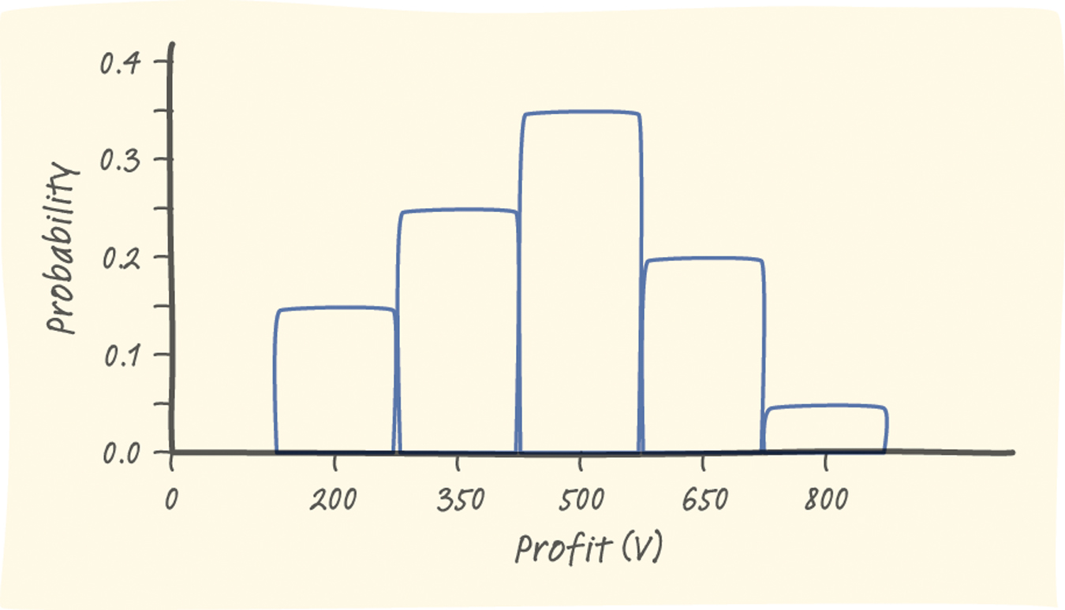
Linear Transformations
Consider Pete’s Jeep Tours again. We defined C as the amount of money Pete collects on a randomly selected day.
Collected c_{i} | 300 | 450 | 600 | 750 | 900
Probability p_{i} | 0.15 | 0.25 | 0.35 | 0.20 | 0.05
The mean of C is $562.50 and the standard deviation is $163.50.
It costs Pete $100 per trip to buy permits, gas, and a ferry pass. The random variable V describes the profit Pete makes on a randomly selected day.
Profit v_{i} | 200 | 350 | 500 | 650 | 800
Probability p_{i} | 0.15 | 0.25 | 0.35 | 0.20 | 0.05
The mean of V is $462.50 and the standard deviation is $163.50.
Compare the shape, center, and spread of the two probability distributions.

Slide 11
Bottom Line:
Whether we are dealing with data or random variables, the effects of a linear transformation are the same!!!

Slide 12
Combining Random Variables

Slide 13
Combining Random Variables
Before we can combine random variables, a determination about the independence of each variable from the other must be made. Probability models often assume independence when the random variables describe outcomes that appear unrelated to each other.
You should always ask yourself whether the assumption of independence seems reasonable.

Slide 14
Combining Random Variables
Let D = the number of passengers on a randomly selected Delta flight to Atlanta
Let A = the number of passengers on a randomly selected trip American Airlines flight to Atlanta
Define T = X + Y. Calculate the mean and standard deviation of T.
Passengers x_{i} | 75 | 76 | 77 | 78 | 79
Probability p_{i} | 0.15 | 0.25 | 0.35 | 0.20 | 0.05
Passengers y_{i} | 75 | 76 | 77 | 78
Probability p_{i} | 0.3 | 0.4 | 0.2 | 0.1

Slide 15
Combining Random Variables
Let D = the number of passengers on a randomly selected Delta flight to Atlanta
Let A = the number of passengers on a randomly selected trip American Airlines flight to Atlanta
Define T = X + Y. Calculate the mean and standard deviation of T.
Passengers x_{i} | 75 | 76 | 77 | 78 | 79
Probability p_{i} | 0.15 | 0.25 | 0.35 | 0.20 | 0.05
Mean µ_{D} = 76.75 Standard Deviation σ_{D}= 1.0897
Passengers y_{i} | 75 | 76 | 77 | 78
Probability p_{i} | 0.3 | 0.4 | 0.2 | 0.1
Mean µ_{A} = 76.1 Standard Deviation σ_{A} = 0.943

Slide 16
Combining Random Variables: Mean
How many total passengers fly to Atlanta on a randomly selected day?
Delta: µ_{D} = 76.75
American: µ_{A} = 76.10
Total: 76.75+ 76.10 = 142.85 passengers to Atlanta daily
For any two random variables X and Y, if T = X + Y, then the expected value of T is
E(T) = µ_{T} = µ_{X} + µ_{Y}
In general, the mean of the sum of several random variables is the sum of their means.

Slide 17
Combining Random Variables: Variance
How much variability is there in the total number of passengers who fly to Atlanta on a randomly selected day? (Hint: find the combined variance)
Delta:
American:
REMEMBER: Standard Deviations do not add!!!
Mean µ_{D} = 76.75 Standard Deviation σ_{D}= 1.0897
Mean µ_{A} = 76.1 Standard Deviation σ_{A} = 0.943

Slide 18
Combining Random Variables: Variance
Delta = (1.090)²
American = (0.943)²
Total Variance = (1.090)² + (0.943)² = 2.077
For any two independent random variables X and Y, if T = X + Y, then the variance of T is
In general, the variance of the sum of several independent random variables is the sum of their variances.

Slide 19
Subtracting Random Variables: Mean
Mean of the Difference of Random Variables
For any two random variables X and Y, if D = X - Y, then the expected value of D is
E(D) = µ_{D} = µ_{X} - µ_{Y}
In general, the mean of the difference of several random variables is the difference of their means. The order of subtraction is important!
Variance of the Difference of Random Variables

Slide 20
Subtracting Random Variables: Variance
Variance of the Difference of Random Variables
For any two independent random variables X and Y, if D = X - Y, then the variance of D is
In general, the variance of the difference of two independent random variables is the sum of their variances.
**This was an FRQ on the 2013 exam**

Slide 21
Combining Normal Random Variables:
Calculating Probabilities
If a random variable is Normally distributed, we can use its mean and standard deviation to compute probabilities.
Important Fact: Any sum or difference of independent Normal random variables is also Normally distributed.

Slide 22
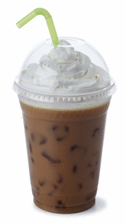
Combining Normal Random Variables: Calculating Probabilities
Mrs. Daniel likes between 8.5 and 9 grams of sugar in her iced coffee. Suppose the amount of sugar in a randomly selected packet follows a Normal distribution with mean 2.17 g and standard deviation 0.08 g. If Mrs. Daniel selects 4 packets at random, what is the probability her iced coffee will taste right?

Slide 23
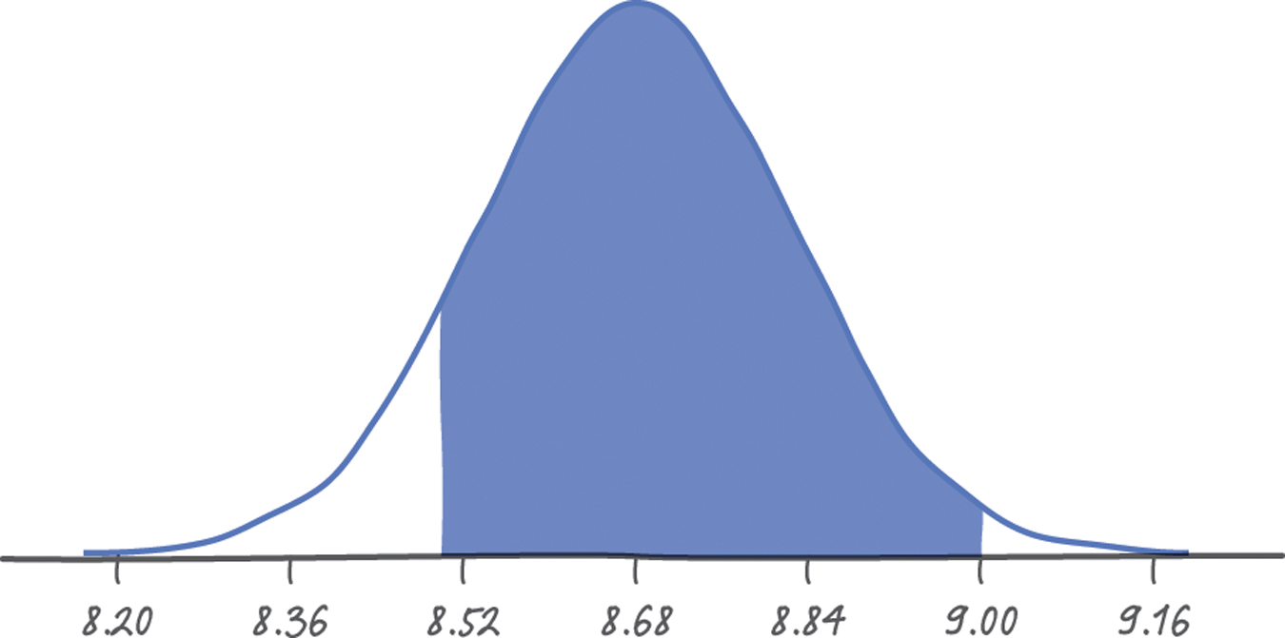
Combining Normal Random Variables: Calculating Probabilities
STATE & PLAN: Let X = the amount of sugar in a randomly selected packet. Then, T = X₁ + X₂ + X₃ + X₄. We want to find P(8.5 ≤ T ≤ 9).

Slide 24
Combining Normal Random Variables: Calculating Probabilities
DO:
Calculate combined mean
Calculate combined variance
Calculate combined standard deviation.
µ_{T} = µ_{X1} + µ_{X2} + µ_{X3} + µ_{X4} = 2.17 + 2.17 + 2.17 +2.17 = 8.68

Slide 25
Combining Normal Random Variables: Calculating Probabilities
4. Calculate z-scores.
5. Find p-values
p-values (z = -1.13) = 0.1292 and (z = 2) 0.9772
6. Final Calculations
0.9772 - 0.1292 = 0.8480
OR normcdf (8.5, 9, 8.68, 0.16) =
CONCLUDE:
There is an 84.8% percent chance that Mrs. Daniel’s iced coffee will taste right.

Slide 26
Combining Normal Random Variables: Calculating Probabilities
YES, you may use your calculator!
Just remember to recalculate the combined mean and standard deviation, before using the calculator!!!!

Slide 27
Combining Normal Random Variables: Calculating Probabilities
The diameter C of a randomly selected large drink cup at a fast-food restaurant follows a Normal distribution with a mean of 3.96 inches and a standard deviation of 0.01 inches. The diameter L of a randomly selected large lid at this restaurant follows a Normal distribution with mean 3.98 inches and standard deviation 0.02 inches.
For a lid to fit on a cup, the value of L has to be bigger than the value of C, but not by more than 0.06 inches.
What’s the probability that a randomly selected large lid will fit on a randomly chosen large drink cup?

Slide 28
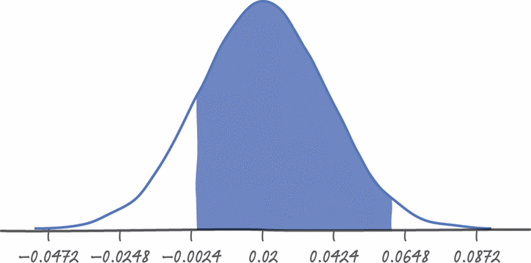
Combining Normal Random Variables: Calculating Probabilities
STATE & PLAN: We’ll define the random variable D = L − C to represent the difference between the lid’s diameter and the cup’s diameter. Our goal is to find P(0.00 < D ≤ 0.06).
DO:
1. Calculate combined mean.
μ_{D} = μ_{L} − μ_{C} = 3.98−3.96 = 0.02
2. Calculate combined variance
(0.02)² + (0.01)² = 0.0005
3. Calculate combined standard deviation.
$\sqrt{0.0005}$ = 0.0224

Slide 29
Combining Normal Random Variables: Calculating Probabilities
DO, cont.:
4. Calculate z-scores:
z = $\frac{0 −0.02}{0.0224}$ = -0.89 and $\frac{0.06−0.02}{0.0224}$ = 1.79
5. Find p-values:
pvalues (z = -0.89) = 0.1867 and (z = 1.79) = 0.9633
6. Final calculations:
0.9633 − 0.1867 = 0.7766.
OR normcdf(0, 0.06, 0.02, 0.0224)=

Slide 30
Combining Normal Random Variables: Calculating Probabilities
CONCLUDE:
We predict that the lids will fit properly 77.66% of the time. This means the lids will not fit properly more than 22% of the time. That is annoying!

Slide 31
Combining Normal Random Variables: Calculating Probabilities
Mrs. Daniel and Mrs. Cooper bowl every Tuesday night. Over the past few years, Mrs. Daniel’s scores have been approximately Normally distributed with a mean of 212 and a standard deviation of 31. During the same period, Mrs. Cooper’s scores have also been approximately Normally distributed with a mean of 230 and a standard deviation of 40. Assuming their scores are independent, what is the probability that Mrs. Daniel scores higher than Mrs. Cooper on a randomly-selected Tuesday night?

Slide 32
Combining Normal Random Variables: Calculating Probabilities

Slide 33
Combining Normal Random Variables: Calculating Probabilities
CONCLUDE:
There is a 35.94% chance that Mrs. Daniel will score higher than Mrs. Cooper on any given night.

Slide 34
Mixed Practice: ACT Scores
Leona and Fred are friendly competitors in high school. Both are about to take the ACT college entrance examination. They agree that if one of them scores 5 or more points better than the other, the loser will buy the winner a pizza. Suppose that in fact Fred and Leona have equal ability, so that each score varies Normally with mean 24 and standard deviation 2. (The variation is due to luck in guessing and the accident of the specific questions being familiar to the student.) The two scores are independent. What is the probability that the scores differ by 5 or more points in either direction?

Slide 35
ACT Scores
New mean: 0
New standard deviation: 2.8284
Normal cdf (-$∞$, -5, 0, 2.8284) = 0.0385
+ normcdf(5, $∞,$ 0, 2.8284) = 0.0385
= 0.0385 + 0.0385 = 0.0771

Slide 36
Mixed Practice: Toothpaste
Mr. Daniel is traveling for his business. He has a new 0.85-ounce tube of toothpaste that’s supposed to last him the whole trip. The amount of toothpaste Mr. Daniel squeezes out of the tube each time he brushes varies according to a Normal distribution with mean 0.13 ounces and standard deviation 0.02 ounces. If Mr. Daniel brushes his teeth six times during the trip, what’s the probability that he’ll be cranky because he ran out of toothpaste?

Slide 37
Toothpaste
New mean: 0.78
New standard deviation: 0.049
Normcdf (0.85, $∞$, 0.78, 0.049) = 0.076564

