Slide 1
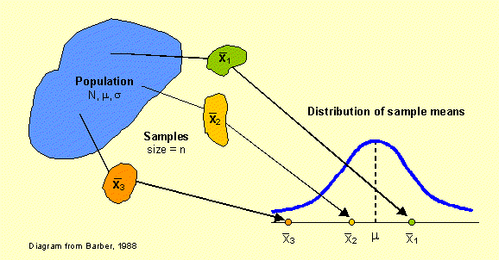
7.1: What is a Sampling Distribution?!?!

Slide 2
Section 7.1 What Is a Sampling Distribution?
After this section, you should be able to…
DISTINGUISH between a parameter and a statistic
DEFINE sampling distribution
DISTINGUISH between population distribution, sampling distribution, and the distribution of sample data
DETERMINE whether a statistic is an unbiased estimator of a population parameter
DESCRIBE the relationship between sample size and the variability of an estimator

Slide 3
The process of statistical inference involves using information from a sample to draw conclusions about a wider population. Different random samples yield different statistics.
We need to be able to describe the sampling distribution of possible statistic values in order to perform statistical inference. We can think of a statistic as a random variable because it takes numerical values that describe the outcomes of the random sampling process.
Population
Sample
Collect data from a representative Sample...
Make an Inference about the Population.

Slide 4
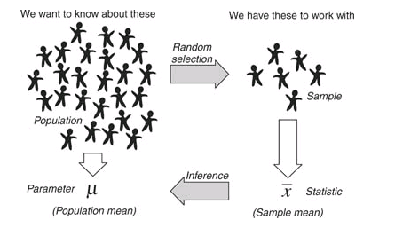

Slide 5
Parameters and Statistics
A parameter is a number that describes some characteristic of the population. In statistical practice, the value of a parameter is usually not known because we cannot examine the entire population.
A statistic is a number that describes some characteristic of a sample. The value of a statistic can be computed directly from the sample data. We use a statistic to estimate an unknown parameter.

Slide 6
Symbols: Parameters and Statistics
 | Proportions | Means | Standard Deviation
Statistic |  |  | s
Parameter | p | µ

Slide 7
Parameter v. Statistic
Identify the population, the parameter (of interest), the sample, and the statistic in each of the following settings.
A pediatrician wants to know the 75th percentile for the distribution of heights of 10-year-old boys so she takes a sample of 50 patients and calculates Q3 = 56 inches.

Slide 8
Parameter v. Statistic
Population: all 10-year-old boys
Parameter: 75th percentile, or Q3
Sample: 50 10-year-old boys included in the sample
Statistic: Q3 = 56 inches.

Slide 9
Parameter v. Statistic
Identify the population, the parameter, the sample, and the statistic in each of the following settings.
A Pew Research Center poll asked 1102 12 to 17-year-olds in the United States if they have a cell phone. Of the respondents, 71% said yes.

Slide 10
Parameter v. Statistic
Population: All 12-17 year olds in the US
Parameter: Proportion with cell phones
Sample: 1102 12-17 year olds with cell phones
Statistic: $\hat{p}$ = 71

Slide 11
Sampling Distribution
The sampling distribution of a statistic is the distribution of values taken by the statistic in all possible samples of the same size from the same population.
In practice, it’s difficult to take all possible samples of size n to obtain the actual sampling distribution of a statistic. Instead, we can use simulation to imitate the process of taking many, many samples.
One of the uses of probability theory in statistics is to obtain sampling distributions without simulation. We’ll get to the theory later.

Slide 12
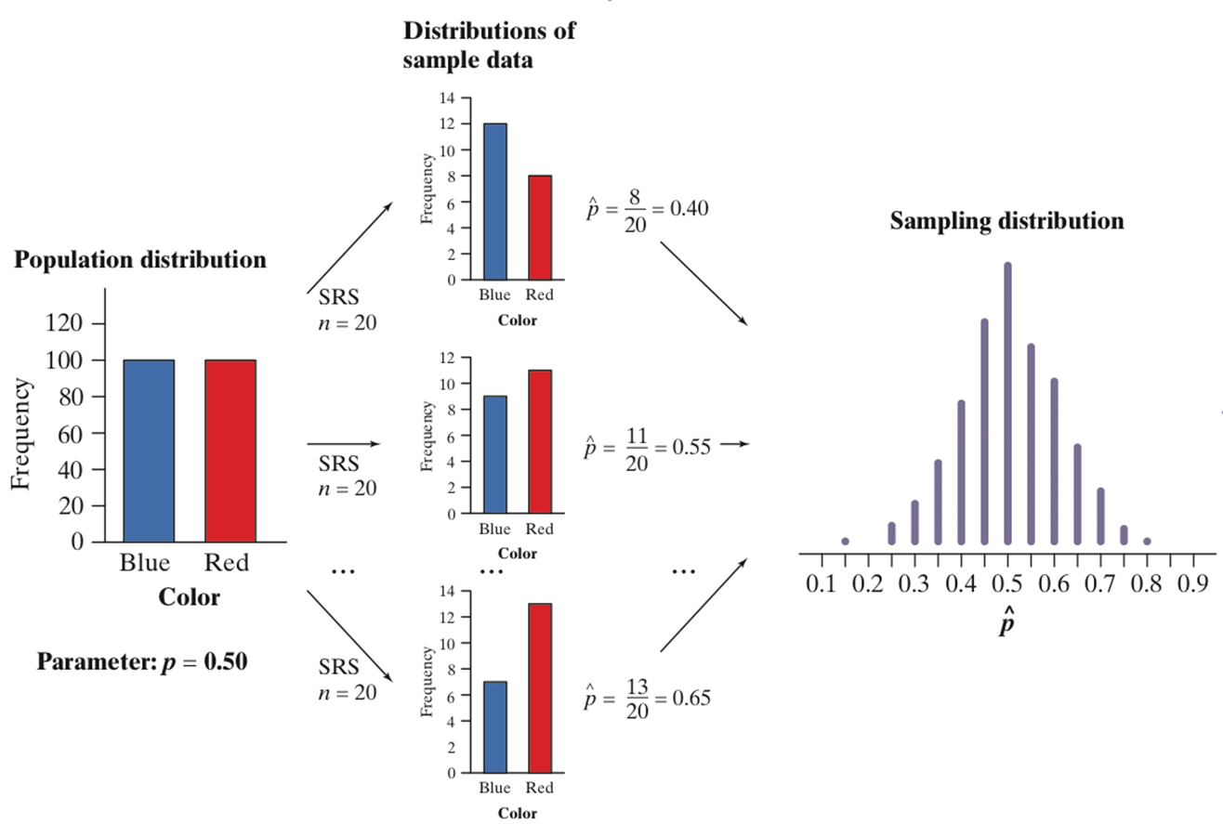

Slide 13
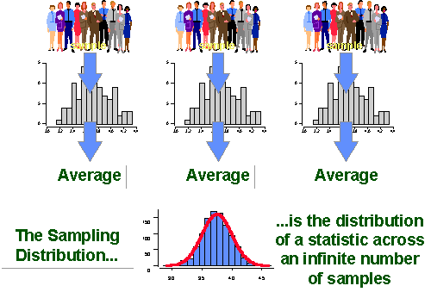

Slide 14
Population Distributions vs. Sampling Distributions
There are actually three distinct distributions involved when we sample repeatedly and measure a variable of interest.
The population distribution gives the values of the variable for all the individuals in the population.
The distribution of sample data shows the values of the variable for all the individuals in the sample.
The sampling distribution shows the statistic values from all the possible samples of the same size from the population.

Slide 15
Hours of Sleep Activity
1. Write your name and the number of hours of sleep (e.g., 7 hours, 8.5 hours) on the paper provided.
2. Select a SRS of 4 cards. Each person will do this.
3. Using your values calculate the sample IQR of sleep hours and the sample maximum of sleep hours. Then, plot your values on the board.
4. Based on these values and the approximate sampling distributions, do either of these statistics appear to be unbiased estimators?

Slide 16
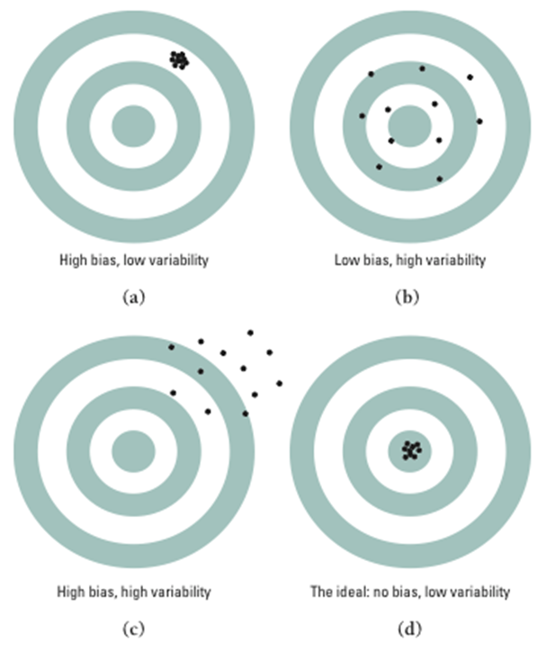
Bias & Variability
Bias means that our aim is off and we consistently miss the bull’s-eye in the same direction. Our sample values do not center on the population value.
High variability means that repeated shots are widely scattered on the target. Repeated samples do not give very similar results.

Slide 17
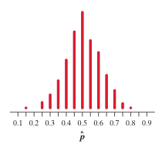
Describing Sampling Distributions: Center
A statistic used to estimate a parameter is an unbiased estimator (most accurate) if the mean of its sampling distribution is equal to the true value of the parameter being estimated.

Slide 18
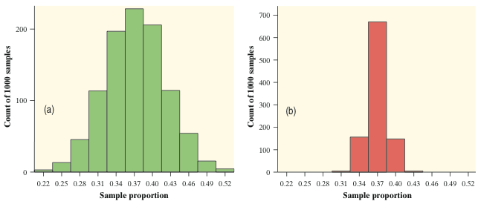
Describing Sampling Distributions: Spread
The variability of a statistic is described by the spread of its sampling distribution. This spread is determined primarily by the size of the random sample. Larger samples give smaller spread. The spread of the sampling distribution does not depend on the size of the population, as long as the population is at least 10 times larger than the sample.
n=100
n=1000

Slide 19
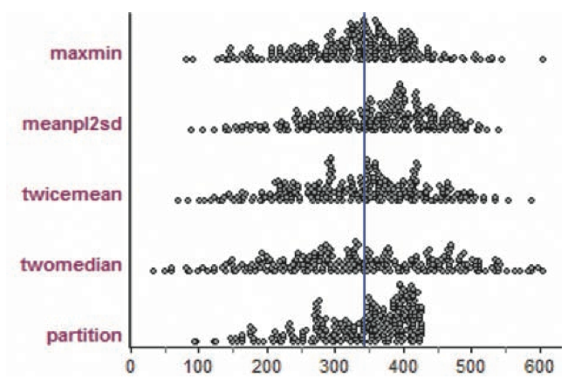
Describing Sampling Distributions: Shape
Sampling distributions can take on many shapes. The same statistic can have sampling distributions with different shapes depending on the population distribution and the sample size.
Sampling distributions for different statistics used to estimate the number of tanks in German during World War 2. The blue line represents the true number of tanks.

Slide 20
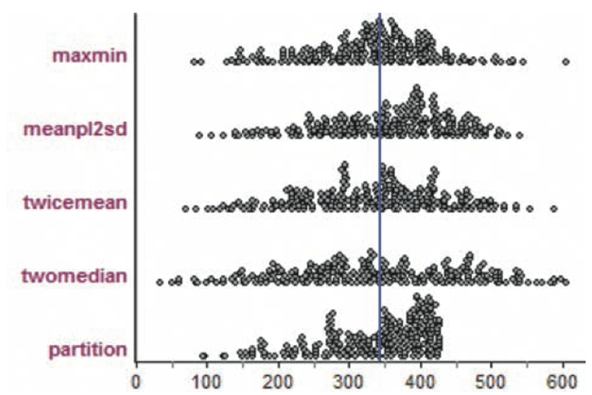
Which of these statistics appear to be biased estimators?
Of the unbiased estimators, which is the best? Explain.

