Slide 1
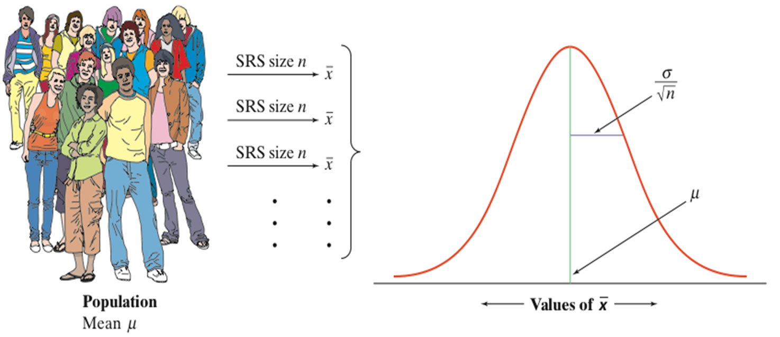
7.3: Sample Means

Slide 2
Section 7.3 Sample Means
After this section, you should be able to…
FIND the mean and standard deviation of the sampling distribution of a sample mean
CALCULATE probabilities involving a sample mean when the population distribution is Normal
EXPLAIN how the shape of the sampling distribution of sample means is related to the shape of the population distribution
APPLY the central limit theorem to help find probabilities involving a sample mean

Slide 3
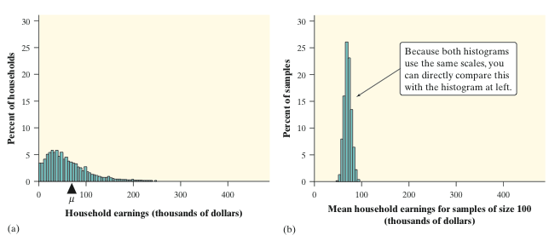
Sample Means
Consider the mean household earnings for samples of size 100. Compare the population distribution on the left with the sampling distribution on the right. What do you notice about the shape, center, and spread of each?

Slide 4
Sample Means Formulas
The mean of the sample distribution:
The Standard Deviation of the sampling distribution:
Notes: The sample size must be less than 10% of the population. The mean and standard deviation of the sample mean are true no matter the same of the population distribution.

Slide 5
REVIEW: Young Women’s Heights
The height of young women follows a Normal distribution with mean µ = 64.5 inches and standard deviation σ = 2.5 inches.
Find the probability that a randomly selected young woman is taller than 66.5 inches.

Slide 6
REVIEW: Young Women’s Heights
STATE: Let X = the height of a randomly selected young woman. X is N(64.5, 2.5).
PLAN: Since the “sample” in this case is only one person, the sample size is clearly smaller than the 10% of the population.
DO:
OR Normalcdf (66.5, 10000, 64.5, 2.5) = 0.2118
CONCLUDE: The probability of choosing a young woman at random whose height exceeds 66.5 inches is about 0.21.

Slide 7
Example: Young Women’s Heights
The height of young women follows a Normal distribution with mean µ = 64.5 inches and standard deviation σ = 2.5 inches.
Find the probability that the mean height of an SRS of 10 young women exceeds 66.5 inches.

Slide 8
Example: Young Women’s Heights
OR normalcdf(66.5, 10000, 64.5, 0.7905) = 0.0057
CONCLUDE: There is a 0.57% percent chance of getting a sample of 10 women with a mean height of 66.5 It is very unlikely (less than a 1% chance) that we would choose an SRS of 10 young women whose average height exceeds 66.5 inches.

Slide 9
Sample Distributions & Normality
If the population is Normal, then the sample distribution is Normal. No further checks are need!
If the population is NOT Normal, then…. If the sample is large enough, the distribution of sample means is “approximately” Normal, no matter what shape the population distribution has, as long as the population has a finite standard deviation.

Slide 10
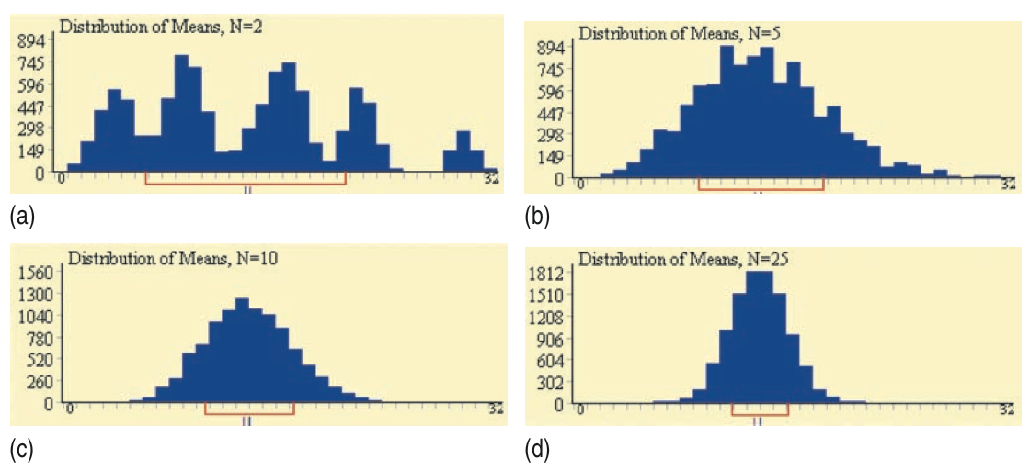
Sample Distributions & Normality:
HOW LARGE IS LARGE ENOUGH?

Slide 11
Sample Distributions & Normality:
HOW LARGE IS LARGE ENOUGH?
If the Population is…. | Minimum Sample Size to assume Normal
Normal | 0
Slightly Skewed | 15
Heavily Skewed | 30

Slide 12
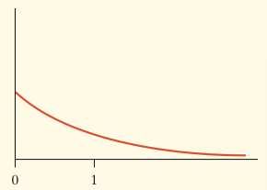
Example: Servicing Air Conditioners
Based on many service records from the past year, the time (in hours) that a technician requires to complete preventative maintenance on an air conditioner follows the distribution that is strongly right-skewed, and whose most likely outcomes are close to 0. The mean time is µ = 1 hour and the standard deviation is σ = 1
Your company will service an SRS of 70 air conditioners. You have budgeted 1.1 hours per unit. Will this be enough? What is the chance that the technicians will not finish within the time frame?

Slide 13
Example: Servicing Air Conditioners
PLAN/STATE:
Independence: It is reasonable to assume that the company has serviced more than 700 unit, therefore the 70 units in the sample represent less than 10% of the population.
Normal: Even though the population has a strong right skew, a sample size of 70 is large enough to assume normality.

Slide 14
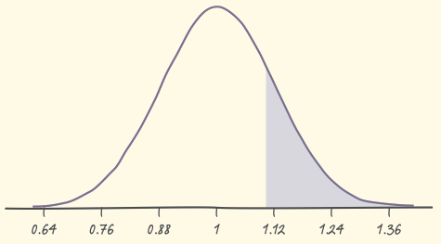
Example: Servicing Air Conditioners
DO:
OR Normalcdf (1.1000001, 10000, 1, 0.1195) = 0.2013
CONCLUDE: If you budget 1.1 hours per unit, there is a 20.13% chance the technicians will not complete the work within the budgeted time.

