Slide 1
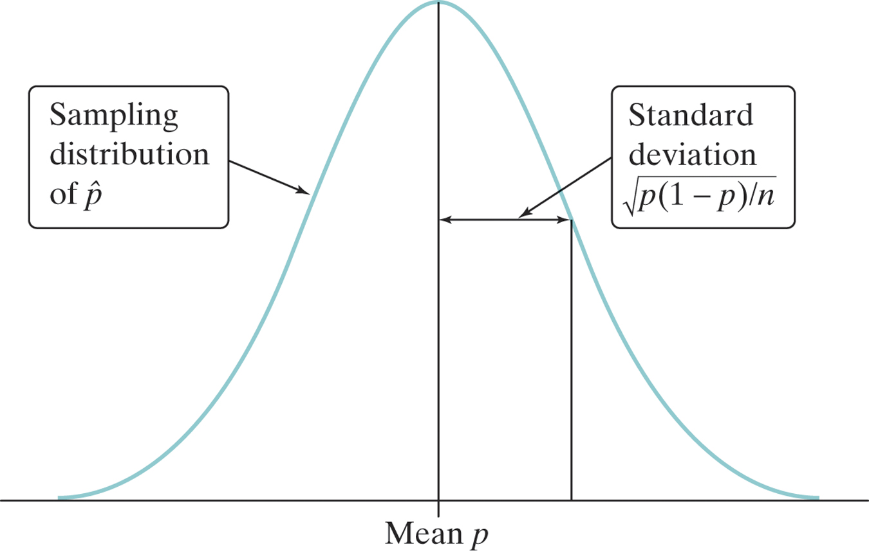
Section 8.2
Estimating a Population Proportion

Slide 2
Section 8.2 Estimating a Population Proportion
After this section, you should be able to…
CONSTRUCT and INTERPRET a confidence interval for a population proportion
DETERMINE the sample size required to obtain a level C confidence interval for a population proportion with a specified margin of error
DESCRIBE how the margin of error of a confidence interval changes with the sample size and the level of confidence C

Slide 4
Estimating p & Constructing a CI: Conditions
1) Random: The data should come from a well-designed random sample or randomized experiment.
2) Normal: The sampling distribution of the statistic is approximately Normal. We can use the Normal approximation to the sampling distribution as long as np ≥ 10 and n(1 – p) ≥ 10. However, if we don’t know p, we can replace p with $\hat{p}$ to check normality.
3) Independent: Individual observations are independent. When sampling without replacement, the sample size n should be no more than 10% of the population size N (the 10% condition).

Slide 5
Formula: Confidence Interval for p
CI Proportions:
$$\hat{p} ± z \sqrt{\frac{\hat{p}(1 − \hat{p})}{n}}$$

Slide 6
The Process: Confidence Intervals
Parameter: p = true proportion….
Assess Conditions:
Random: SRS or random assignment
Sample Size: be sure to show both np ≥ 10 and n(1 – p) ≥ 10, the formula plugged and a sentence stating the values are greater than 10, therefore normal. Independent: 10% rule
Name Interval: 1-proportion z-Interval
Interval: Use your calculator. “We are ____% confident that the interval from ____ to ____ will capture the true proportion of (context)…”
Conclude in Context: Answer the question being asked.

Slide 7
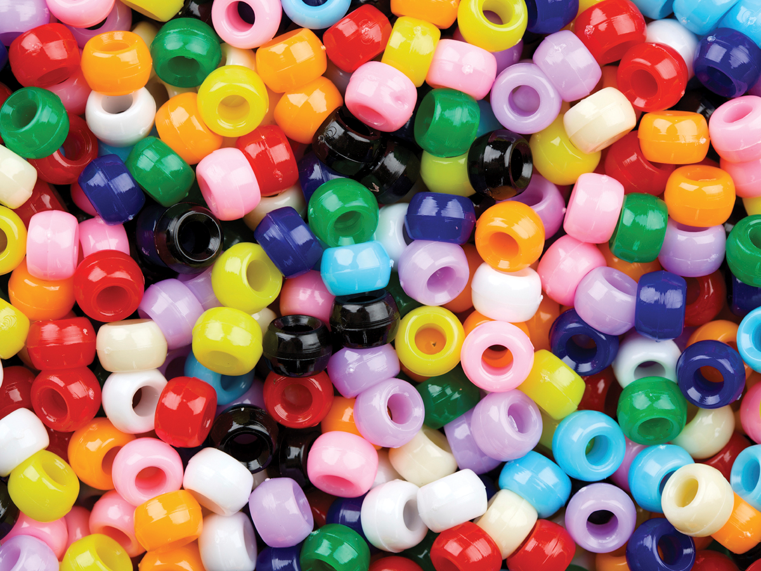
Example: Red Beads
Calculate and interpret a 90% confidence interval for the proportion of red beads in the container of 3000 beads. Mrs. Filtz claims 50% of the beads are red. Use your interval to comment on this claim. The sample proportion you found was 0.426 with a sample of 251 beads.
z | .03 | .04 | .05
– 1.7 | .0418 | .0409 | .0401
– 1.6 | .0516 | .0505 | .0495
– 1.5 | .0630 | .0618 | .0606
For a 90% confidence level, z* = 1.645

Slide 8
Example: Red Beads
Parameter: p = true proportion of red beads
Assess Conditions:
Random: It is reasonable to assume that the sample was randomly collected.
Sample Size: Since both n$\hat{p}$ ≥ 10 (251x 0.426 = 106.9) and n(1 – $\hat{p}$) ≥ 10 (251 x 1-.426 = 144.1) are both greater than 10, our sample size is large enough.
Independent: Since the sample of 251 is less than 10% of the population (3000 beads), it is reasonable to assume independence when sampling without replacement.

Slide 9
Example: Red Beads
Name Interval: 1-proportion z-Interval
Interval:
We are 90% confident that the interval from 0.375 to 0.477 will capture the true proportion of red beads.
statistic ± (critical value) • (standard deviation of the statistic)
0.426 +/- 1.645 *

Slide 10
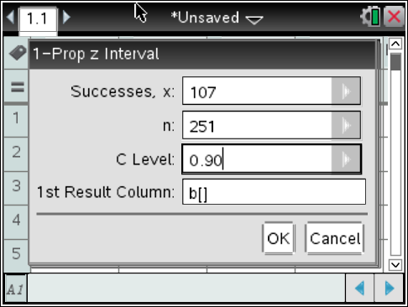
Example: Red Beads
Name Interval: 1-proportion z-Interval
Interval: (0.375, 0.477)
We are 90% confident that the interval from 0.375 to 0.477 will capture the true proportion of red beads.
NOTE:
.426 (251) = 106.929
or 107 beads
*ALWAYS ROUND UP TO A WHOLE NUMBER TO INPUT INTO TI-84

Slide 11
Example: Red Beads
Conclude in Context:
It is pretty doubtful that Mrs. Filtz’s claim in true that 50% of the beads are red because 0.50 is not included within the interval.

Slide 12
Free Response 2011B #5
During a flu vaccine shortage in the United States, it was believed that 45 percent of vaccine-eligible people received flu vaccine. The results of a survey given to a random sample of 2,350 vaccine-eligible people indicated that 978 of the 2,350 people had received flu vaccine.
(a) Construct a 99 percent confidence interval for the proportion of vaccine-eligible people who had received flu vaccine. Use your confidence interval to comment on the belief that 45 percent of the vaccine-eligible people had received flu vaccine.

Slide 13
Parameter: p = true proportion of vaccine eligible people receiving flu shot
Assess Conditions:
Random: Random sample, stated.
Sample Size: Since both n$\hat{p}$ ≥ 10 (978) and n(1 – $\hat{p}$) ≥ 10 (1372) are both greater than 10, our sample size is considered large enough.
Independent: Since the sample of 2350 is less than 10% of the population (23,500 adults), it is reasonable to assume independence when sampling without replacement.

Slide 14
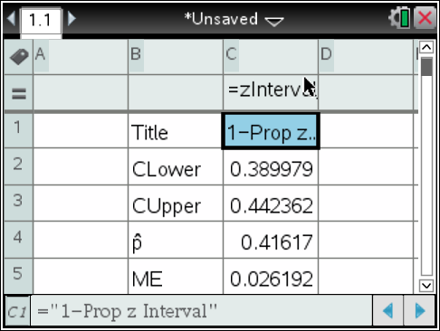
Name Interval: 1-proportion z-Interval
Interval:
We are 99% confident that the interval from 0.38998 to 0.44236 will capture the true proportion of vaccine eligible adults receiving the flu shot.
Conclude in Context: Since 0.45 (45%) is not contained within the interval, we have reasonable evidence that 45% of eligible adults did not get vaccinated.

Slide 16
Scoring
Part a:
1 point:
Name interval
Check random condition
Check sample size condition
1 point:
Correct interval with sentence
1 point:
Correct conclusion about 45% vaccination claim

Slide 17
Calculating the Minimum Sample Size
In planning a study, we may want to choose a sample size that allows us to estimate a population proportion within a given margin of error by plugging in the desired margin of error (ME), the desired confidence level (z-score) and the known $\hat{p}$ to the margin of error formula. We then solve for n.
If the sample proportion is unknown we use $\hat{p}$ = 0.5 as our best guess, because ME will be largest when $\hat{p}$ = 0.5.

Slide 18
Example: Customer Satisfaction
McDonald's wants to determine customer satisfaction with its new BBQ Chicken Burger. The VP of New Products has hired you to conduct a survey. At a minimum how many people do you need to survey, if the company is requiring a margin of error of 0.03 at 95% confidence?

Slide 19
Example: Customer Satisfaction
MacDonald's wants to determine customer satisfaction with its new BBQ Chicken Burger. The VP of New Products has hired you to conduct a survey. At a minimum how many people do you need to survey, if the company is requiring a margin of error of 0.03 at 95% confidence?
Multiply both sides by square root n and divide both sides by 0.03.
Square both sides.
We round up to 1068 respondents to ensure the margin of error is no more than 0.03 at 95% confidence.
Substitute 0.5 for the sample proportion to find the largest ME possible.

Slide 20
2011B #5b
(b) Suppose a similar survey will be given to vaccine-eligible people in Canada by Canadian health officials. A 99 percent confidence interval for the proportion of people who will have received flu vaccine is to be constructed. What is the smallest sample size that can be used to guarantee that the margin of error will be less than or equal to 0.02 ?

Slide 21
Solution
The sample-size calculation uses 0.5 as the value of the proportion in order to provide the minimum required sample size to guarantee that the resulting interval will have a margin of error no larger than 0.02.
A sample of at least 4,148 vaccine-eligible people should be taken in Canada.

Slide 22
Summary

