Slide 1
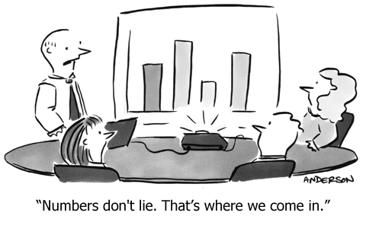
Chapter 1 Introduction & 1.1: Analyzing Categorical Data

Slide 2
Introduction
Data Analysis: Making Sense of Data
After this section, you should be able to…
  DEFINE “Individuals” and “Variables”
  DISTINGUISH between “Categorical” and “Quantitative” variables
  DEFINE “Distribution”
  DESCRIBE the idea behind “Inference”

Slide 3
What is the Study of Statistics?!
Statistics is the science of data.
In this course we study four different aspects of statistics:
  Data Analysis (Chapters 1 to 3)
    The process of organizing, displaying, summarizing, and asking questions about data.
  Data Collection (Chapter 4)
    The process of conducting and interpreting surveys and experiments.
  Anticipating Patterns/Probability (Chapter 5 to 7)
    The process of using probability and chance to explain natural phenomena.
  Inference (Chapter 8 to 12)
    The process of making predications and evaluations about a population from a sample.

Slide 4
Population
Sample
Collect data from a representative sample...
Make an inference about the population.
Perform Data Analysis, keeping probability in mind…

Slide 5
Variable - any characteristic of an individual or object
Categorical Variable
- Usually an adjective
Rarely a number
Examples:
Gender
Race
Grade in School (Sophomore, Jr., Sr.)
Zip Code
Quantitative Variable
Always a number
Must be able to find the mean of the numbers
Examples:
Weight
Height
GPA
# of AP Classes taken
Square footage

Slide 6
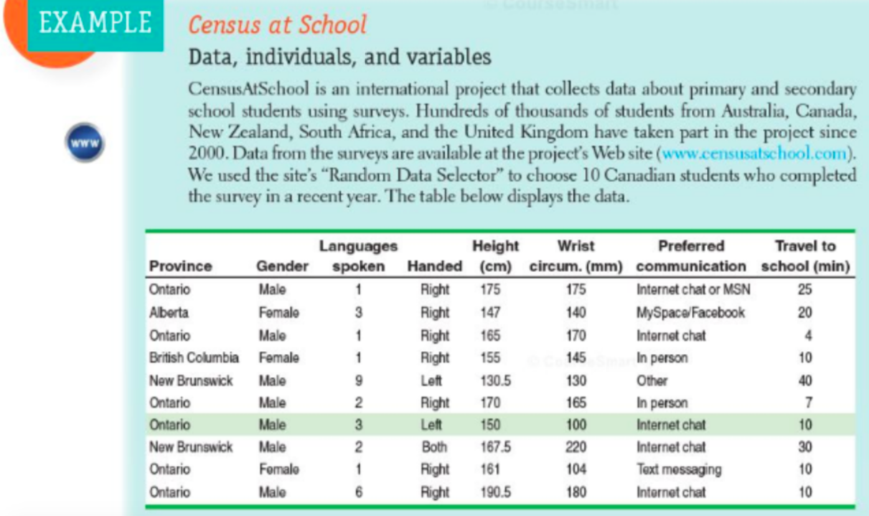
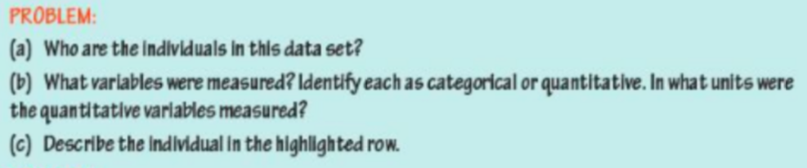

Slide 7
Distribution
Distribution: describes what values a variable takes and how often it takes those values
Essentially “distribution” replaces the words “data” or “graph”.
The median of the distribution is 28.
The distribution is skewed left.
Dotplot of MPG Distribution

Slide 8

Practice

Slide 9
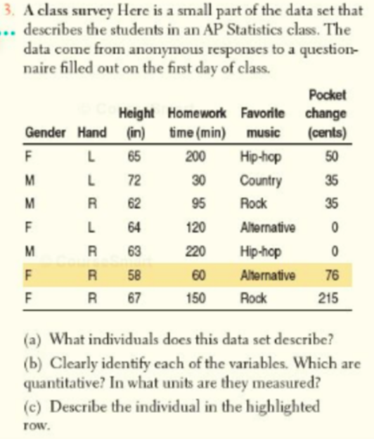

Slide 10
