Slide 1
Unit 3: Conics
Helpful Study Questions

Slide 3
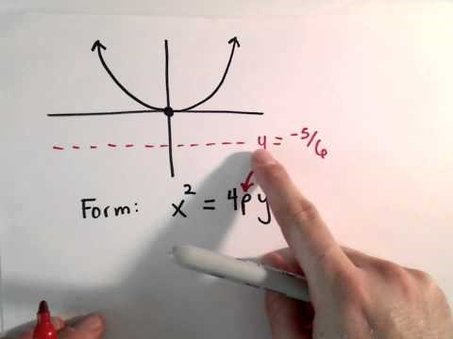
8.1 (Writing the equation of a parabola)

Slide 4
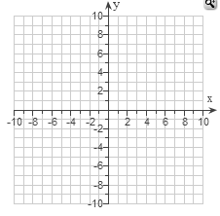
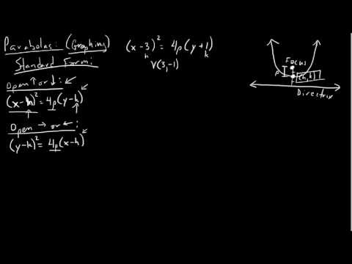
8.1 (Writing the equation of a parabola)

Slide 5
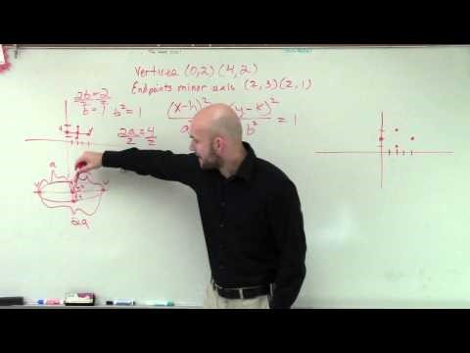
8.2 (Writing the equation of an ellipse)

Slide 6
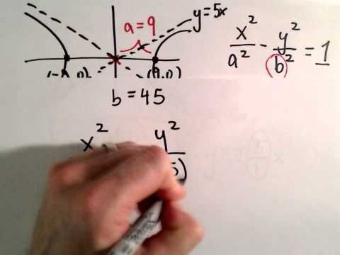
8.3 (Writing the equation of a hyperbola)

Slide 7
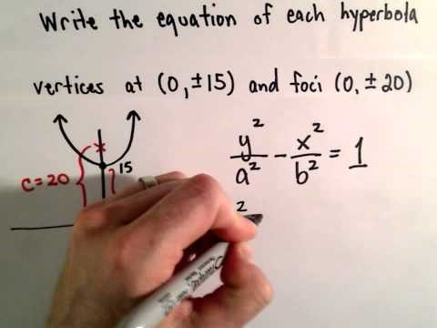
8.3 (Writing the equation of a hyperbola)

Slide 8
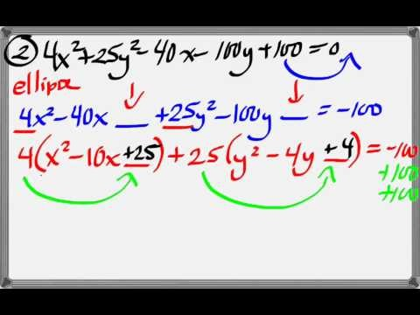
Completing the Square Review

