Slide 1
Derivatives of Inverse Trigonometric Functions
and
Derivatives of other Inverse Functions

Slide 2
Example 1:
$$y=\sin{x}$$
When you create an inverse you switch the x and the y.
$$x=\sin{y}$$
Then you solve for y.
This is not a function! ☹
$$y=\sin^{−1}{x}$$

Slide 3
Hence, the inverse
$$y=\sin^{−1}{x}$$
Will be a function
To make this a function you restrict the domain of
$$y=\sin{x.}$$

Slide 4
Definition of Inverse Trigonometric Function
Function | Domain | Range
$y=arc\sin{x}$ iff $\sin{y=x}$ | $$−1≤x≤1$$ | $$−\frac{π}{2}≤y≤\frac{π}{2}$$
$y=arc\cos{x}$ iff $\cos{y=x}$ | $$−1≤x≤1$$ | $$0≤y≤π$$
$y=arc\tan{x}$ iff $\tan{y=x}$ | $$−∞<x<∞$$ | $$−\frac{π}{2}<y<\frac{π}{2}$$
$y=arc\cot{x}$ iff $\cot{y=x}$ | $$−∞<x<∞$$ | $$0<y<π$$
$y=arc\sec{x}$ iff $\sec{y}=x$ | $$\left|x\right|≥1$$ | $0≤y≤π$, $y≠\frac{π}{2}$
$y=arc\csc{x}$ iff $\csc{y}=x$ | $$\left|x\right|≥1$$ | $−\frac{π}{2}≤y≤\frac{π}{2}$, $y≠0$

Slide 5
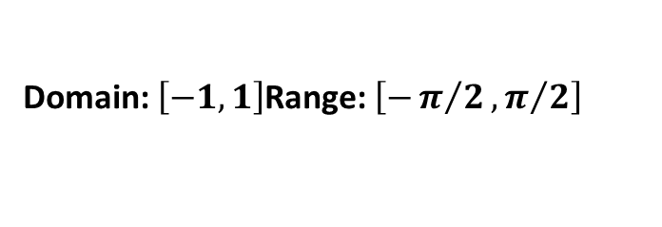
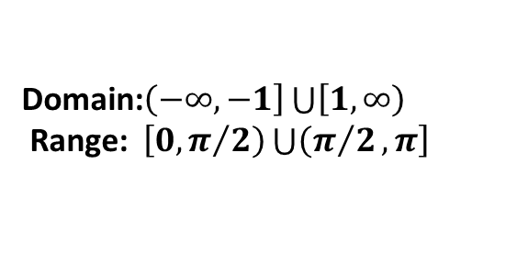
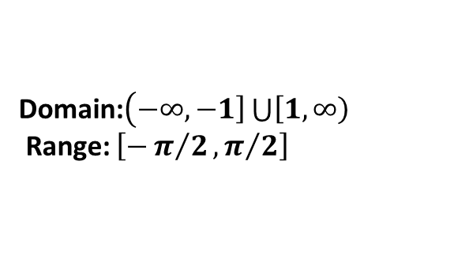
Graphs of Inverse Trigonometric Functions
$$y=\sin^{−1}{x}$$
$$y=\cos^{−1}{x}$$
$$y=\tan^{−1}{x}$$
Domain: $\left[−1,1\right]$Range: $\left[−π/2,π/2\right]$
Domain: $\left[−1,1\right]$Range: $\left[0,π \right]$
Domain:$\left(−∞,∞\right)$Range:$\left(−π/2,π/2\right)$
$$y=\csc^{−1}{x}$$
$$y=\sec^{−1}{x}$$
$$y=\cot^{−1}{x}$$
Domain:$\left(−∞,\left.−1\right]\bigcup{\left[1,\left.∞\right)\right.}\right.$
Range: $\left[−π/2,π/2\right]$
Domain:$\left(−∞,\left.−1\right]\bigcup{\left[1,\left.∞\right)\right.}\right.$
Range: $\left[0,\left.π/2\right)\bigcup{\left(π/2\left.,π\right]\right.}\right.$
Domain:$\left(−∞,∞\right)$Range:$\left(0,π \right)$

Slide 6
Let’s derive the derivative of $y=arc\sin{x}$.

Slide 8
Theorem 5.16 Derivatives of an Inverse Trigonometric Function
$$\frac{d}{dx}\left[arc\sin{u}\right]=\frac{u′}{\sqrt{1−u^{2}}}$$ | $$\frac{d}{dx}\left[arc\cos{u}\right]=\frac{−u′}{\sqrt{1−u^{2}}}$$
$$\frac{d}{dx}\left[\arctan{u}\right]=\frac{u′}{1+u^{2}}$$ | $$\frac{d}{dx}\left[\operatorname{arccot}{u}\right]=\frac{−u′}{1+u^{2}}$$
$$\frac{d}{dx}\left[\operatorname{arcsec}{u}\right]=\frac{u′}{\left|u\right|\sqrt{u^{2}−1}}$$ | $$\frac{d}{dx}\left[\operatorname{arccsc}{u}\right]=\frac{−u′}{\left|u\right|\sqrt{u^{2}−1}}$$

Slide 9
Examples:

Slide 10
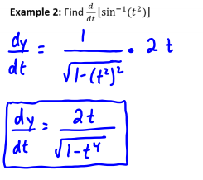

Slide 11
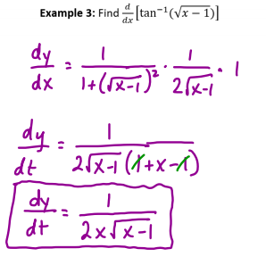

Slide 12
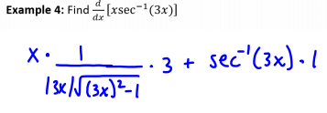
$$\frac{dy}{dx}={\frac{3x}{\left|3x\right|\sqrt{{9x}^{2}−1}}+}{\sec^{−1}{3x}}$$

Slide 13
Continuity and Differentiability of Inverse Functions
Let $f$ be a function whose domain is an interval $I$. If $f$ has an inverse function, then the following statements are true. If $f$ is continuous on its domain, then $f^{−1}$ is continuous on its domain. 2) If $f$ is differentiable on an interval containing $c$ and $f′(c)≠0$, the $f^{−1}$ is differentiable at $f(c)$.

Slide 14
Analyzing Inverse Relationships

Slide 16
Derivative of an Inverse Function
Let $f$ be a function that is differentiable on an interval . If $f$ has an inverse function $g$, then $g$ is differentiable at any $x$ for which $f^{′}\left(g\left(x\right)\right)≠0$. Moreover, $g^{′}\left(x\right)=\frac{1}{f′(g\left(x\right))}$ , $f′(g\left(x\right))≠0$

Slide 17
More examples…

Slide 18
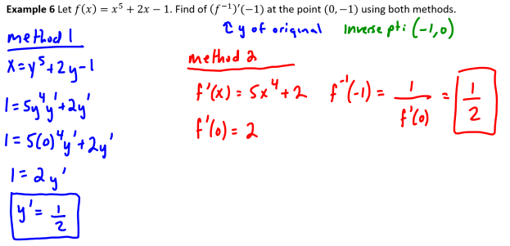

Slide 19
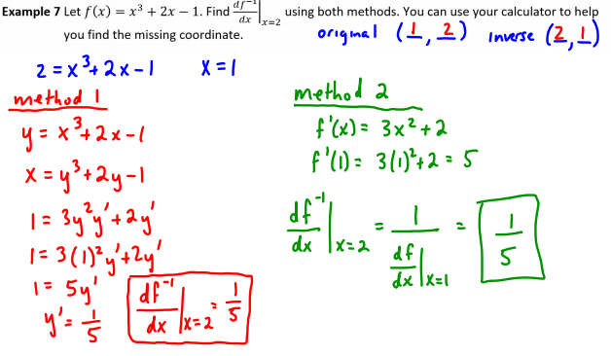

Slide 20
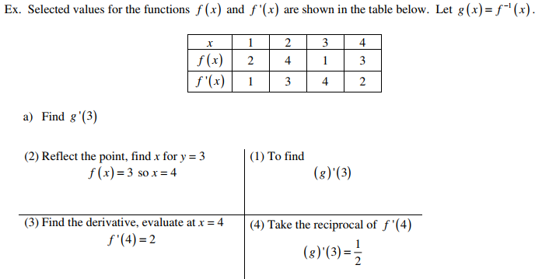
Finding the Derivative of an Inverse Function by using a table

Slide 21
PRACTICE: Find g’(4)

Slide 22
