Slide 1
Exponential Growth & Decay
A Calculus Perspective

Slide 4
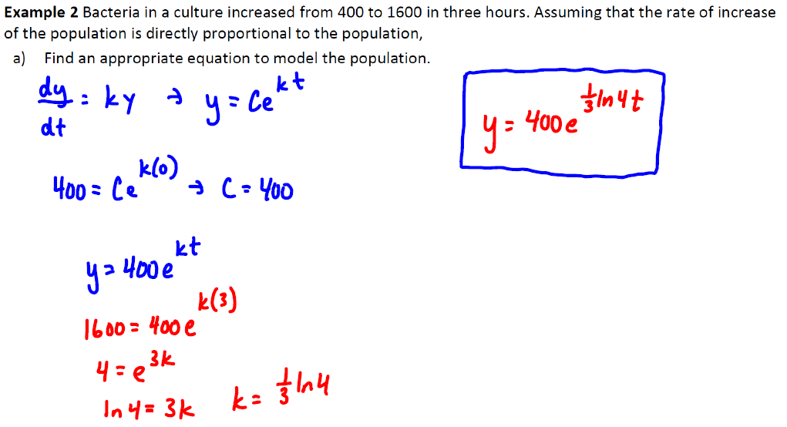

Slide 5
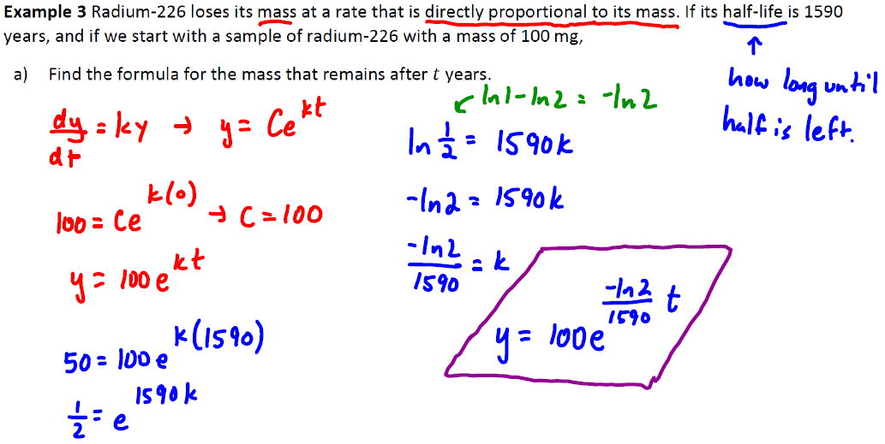

Slide 6
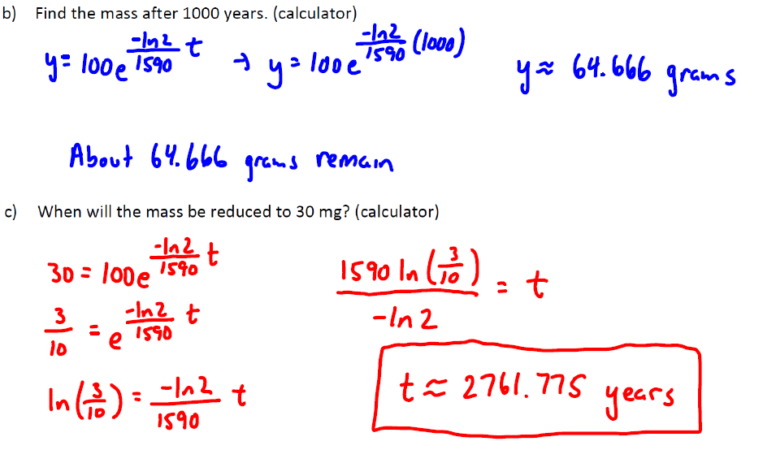

Slide 10
