Slide 1
Increasing and Decreasing Functions and the
First Derivative Test
Section 3.3

Slide 2
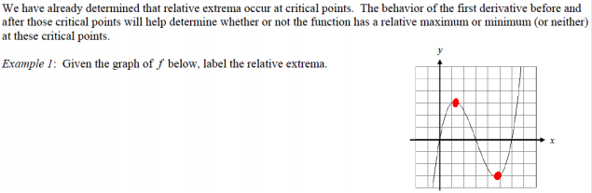
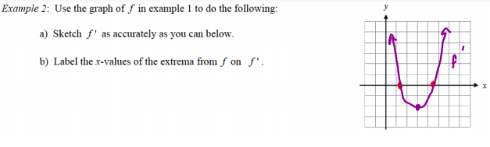

Slide 3
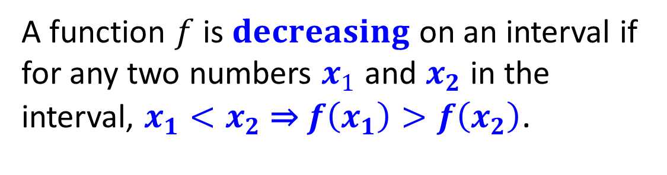

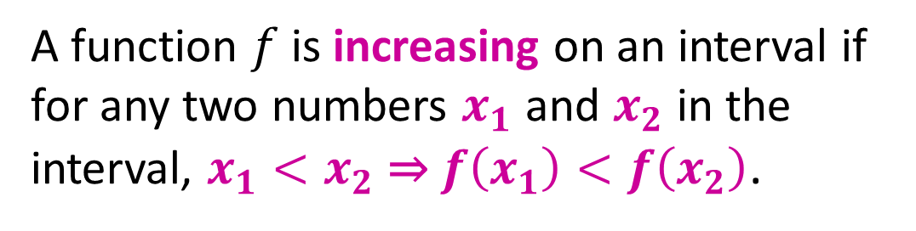





Definitions of Increasing and Decreasing Functions
$$f\left(x_{2}\right)$$
A function $f$ is increasing on an interval if for any two numbers $x_{1}$ and $x_{2}$ in the interval, $x_{1}<x_{2}$ ⇒ $f\left(x_{1}\right)<f\left(x_{2}\right)$.
$$f\left(x_{1}\right)$$
$$f\left(x_{1}\right)$$
$$x_{1} x_{2}$$
$$f\left(x_{2}\right)$$
A function $f$ is $decreasing$ on an interval if for any two numbers $x_{1}$ and $x_{2}$ in the interval, $x_{1}<x_{2}$ ⇒ $f\left(x_{1}\right)>f\left(x_{2}\right)$.
$$x_{1} x_{2}$$

Slide 4




$$f^{′}(x)<0$$
$$f^{′}\left(x\right)=0$$
$$f^{′}(x)>0$$
As $x$ moves from left to right
Decreasing- Graph moves down Increasing- Graph moves up

Slide 5
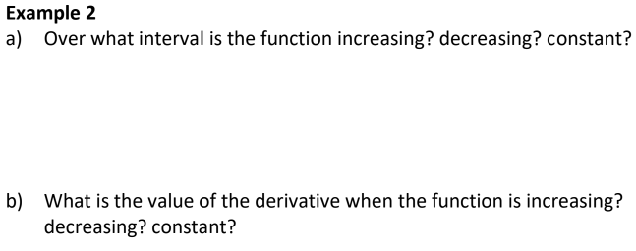
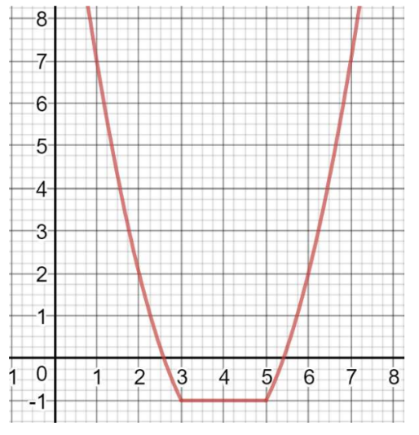

Slide 6
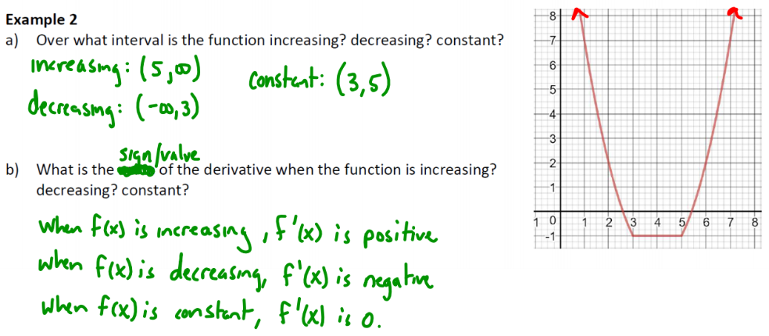

Slide 7
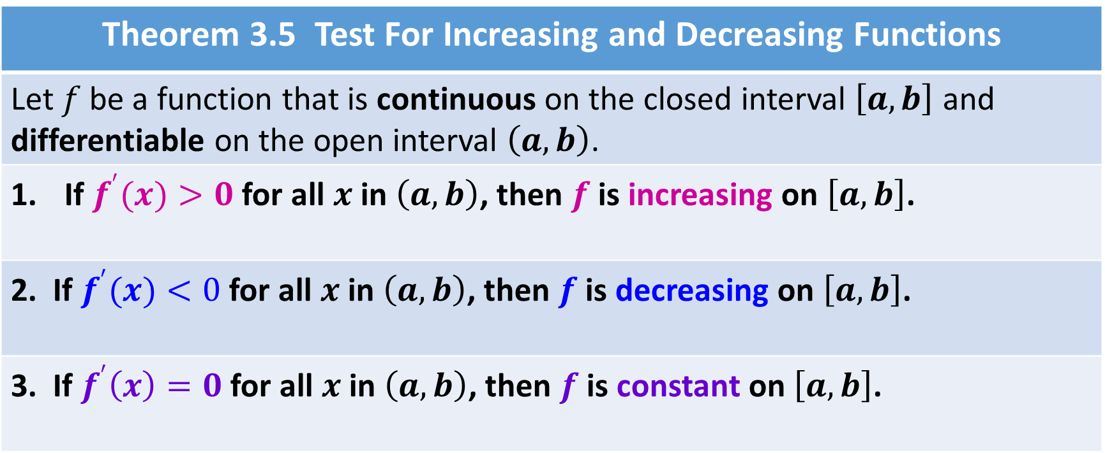
Theorem 3.5 Test For Increasing and Decreasing Functions
Let $f$ be a function that is continuous on the closed interval $\left[a,b\right]$ and differentiable on the open interval $\left(a,b\right)$.
If $f^{′}(x)>0$ for all $x$ in $\left(a,b\right)$, then $f$ is increasing on $\left[a,b\right]$.
2. If $f^{′}(x)<0$ for all $x$ in $\left(a,b\right)$, then $f$ is decreasing on $\left[a,b\right]$.
3. If $f^{′}\left(x\right)=0$ for all $x$ in $\left(a,b\right)$, then $f$ is constant on $\left[a,b\right]$.

Slide 8
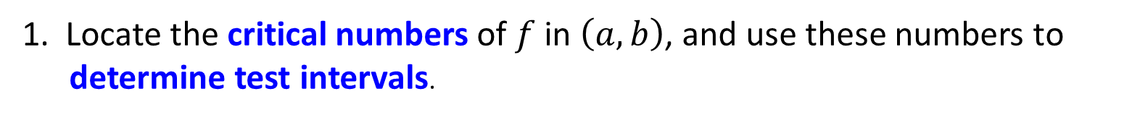

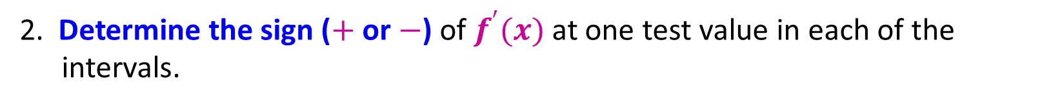
Guidelines for Finding Intervals on Which a Function is Increasing or Decreasing
Let $f$ be continuous on the interval $\left(a,b\right)$. To find the open intervals on which $f$ is increasing or decreasing, use the following steps.
1. Locate the critical numbers of $f$ in $\left(a,b\right)$, and use these numbers to determine test intervals.
2. Determine the sign ($+$ or $−$) of $f^{′}(x)$ at one test value in each of the intervals.
3. Use Theorem 3.5 to determine whether $f$ is increasing or decreasing on each interval.
These guidelines are also valid if the interval $\left(a,b\right)$ is replaced by an interval of the form $\left(−∞, b\right)$, $\left(a,∞\right)$, or $\left(−∞,∞\right)$.

Slide 9


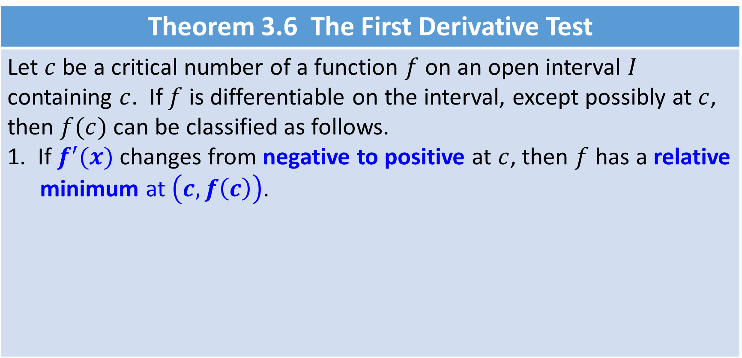






Theorem 3.6 The First Derivative Test
Let $c$ be a critical number of a function $f$ on an open interval $I$ containing $c$. If $f$ is differentiable on the interval, except possibly at $c$, then $f(c)$ can be classified as follows. 1. If $f^{′}(x)$ changes from negative to positive at $c$, then $f$ has a relative minimum at $\left(c, f\left(c\right)\right)$.
$f^{′}\left(c\right)$ is undefined
$$f^{′}\left(c\right)=0$$
$(−)$ $\left(+\right)$
$(−)$ $\left(+\right)$
$f^{′}(x)<0$ $f^{′}(x)>0$
$f^{′}(x)<0$ $f^{′}(x)>0$
$a$ $c$ $b$
$$c$$
Relative Minimum
Relative Minimum

Slide 10









Theorem 3.6 The First Derivative Test
2. If $f^{′}(x)$ changes from positive to negative at $c$, the $f$ has a relative maximum at $\left(c, f\left(c\right)\right)$.
$(+)$ $\left(−\right)$
$(+)$ $\left(−\right)$
$f^{′}\left(x\right)>0$ $f^{′}\left(x\right)<0$
$f^{′}\left(x\right)>0$ $f^{′}\left(x\right)<0$
$a$ $c$ $b$
$$c$$
Relative Maximum
Relative Maximum
$$f^{′}\left(c\right)=0$$
$f^{′}\left(c\right)$ is undefined

Slide 11


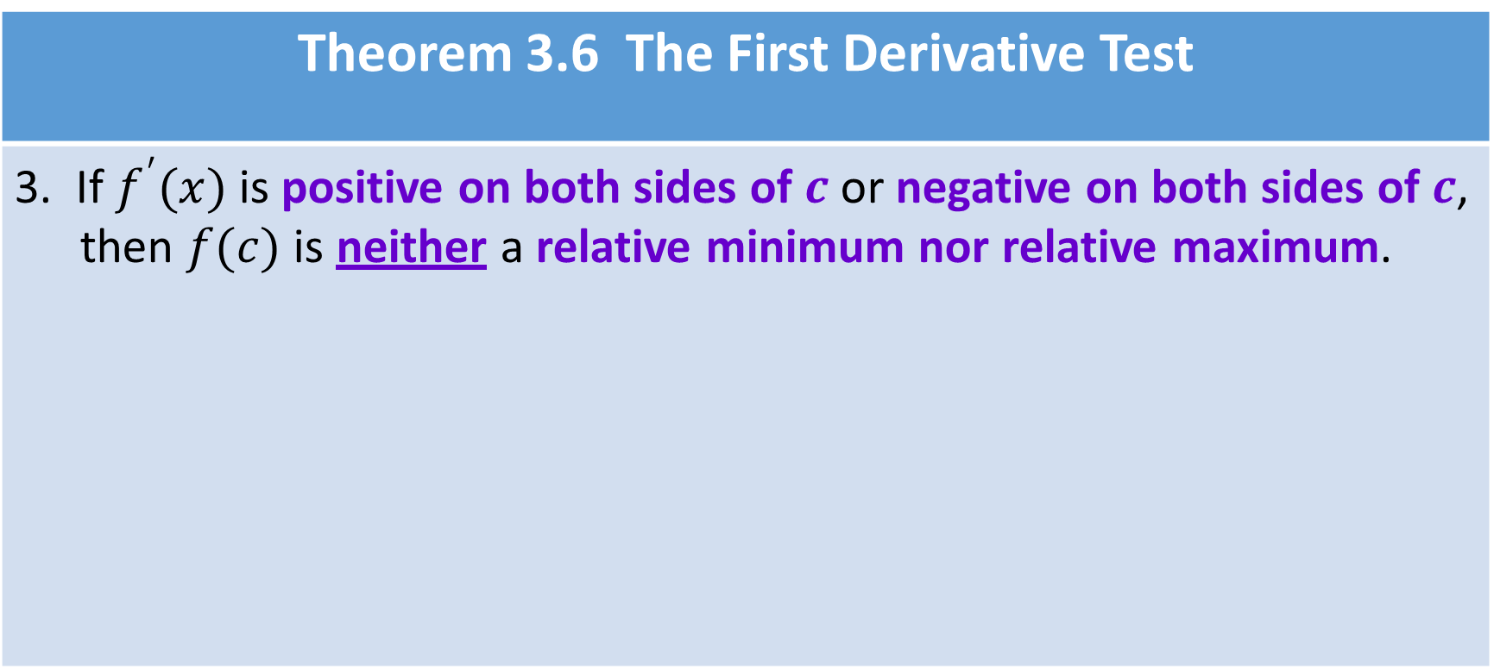




Theorem 3.6 The First Derivative Test
3. If $f^{′}(x)$ is positive on both sides of $c$ or negative on both sides of $c$, then $f(c)$ is neither a relative minimum nor relative maximum.
$(+)$ $\left(+\right)$
$(−)$ $\left(−\right)$
$a$ $c$ $b$
$a$ $c$ $b$
$f^{′}\left(x\right)>0$ $f^{′}(x)>0$
$f^{′}(x)<0$ $f^{′}\left(x\right)<0$
Neither a relative maximum nor a relative minimum

Slide 12
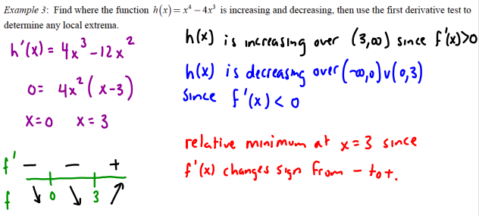

Slide 13
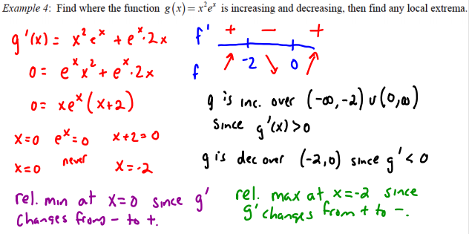

Slide 14
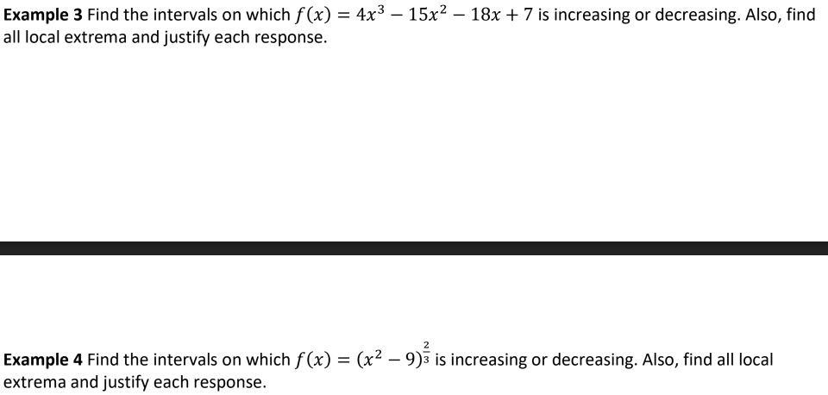

Slide 15
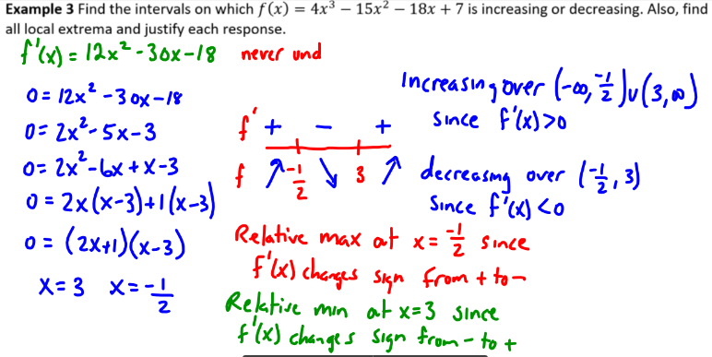

Slide 16
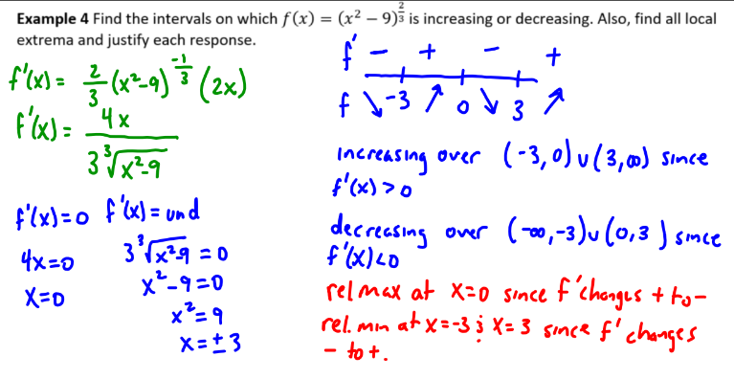

Slide 17

YOU TRY!
Identify intervals of increasing/decreasing when you are given $f$.
Identify relative maximum and relative minimum when you are given $f$.

Slide 18

YOU TRY!
Identify intervals of increasing/decreasing when you are given $f′$.
Identify relative maximum and relative minimum when you are given $f′$.

Slide 19
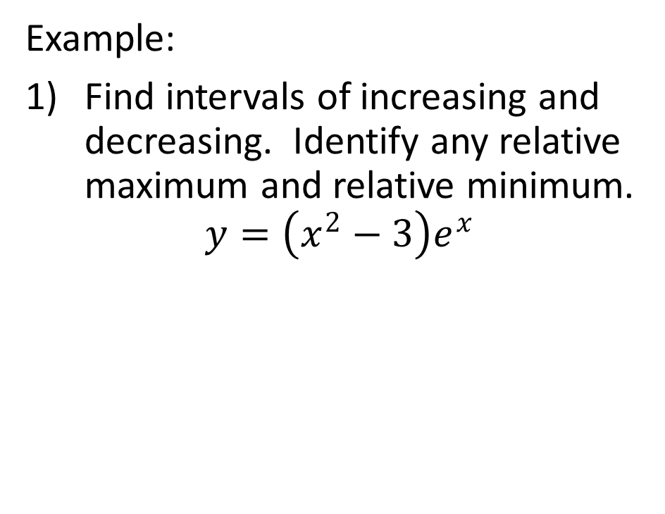
YOU TRY!
Example:
Find intervals of increasing and decreasing. Identify any relative maximum and relative minimum.
$$y=\left(x^{2}−3\right)e^{x}$$

