Slide 1
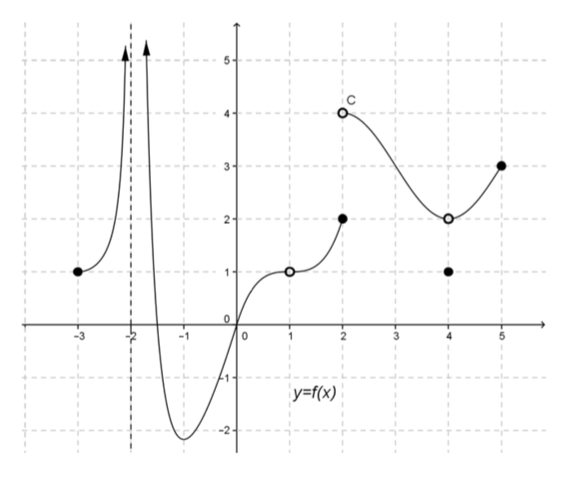
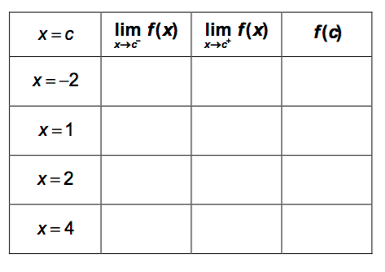
Using the graph, complete the following table:

Slide 3
Intermediate Value Theorem

Slide 5
Intermediate Value Theorem for Continuous Functions

Slide 6
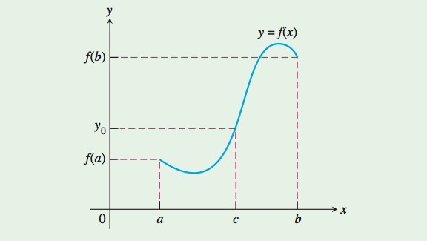
Intermediate Value Theorem

Slide 7
Intermediate Value Theorem for Continuous Functions
Intermediate Value Theorem for Continuous Functions
The Intermediate Value Theorem for Continuous Functions is the reason why the graph of a function continuous on an interval cannot have any breaks. The graph will be connected, a single, unbroken curve. It will not have
jumps or separate branches.

Slide 9
