Slide 1
Mean Value Theorem

Slide 2
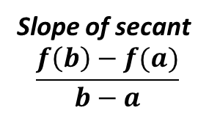
Theorem 3.3- Mean Value Theorem
If $f$ is continuous on the closed interval $\left[a,b\right]$ and differentiable on the open interval $\left(a,b\right)$, then there exist a number $c$ in $\left(a,b\right)$ such that $$f^{′}\left(c\right)=\frac{f\left(b\right)−f(a)}{b−a}.$$
Tangent line is parallel to secant line
$$f^{′}(c)$$
Slope of secant
$$\frac{f\left(b\right)−f(a)}{b−a}$$
Secant line

Slide 5
Note: ALWAYS check for continuity & differentiability before beginning work!!! It will save you from doing unnecessary work. Know ALL of the functions that have continuity issues and differentiability issues.

Slide 6
Example 2
Finding the instantaneous Rate of Change
Two stationary patrol cars equipped with radars are 5 miles apart on a highway, as shown in the figure. As a truck passes the first patrol car, its speed is clocked at 55 miles per hour. Four minutes later, when the truck passes the second car patrol car, its speed is clocked at 50 miles per hour. Prove that the truck must have exceeded the speed limit (of 55 miles per hour) at some time during the 4 minutes.

Slide 7
Practice Review

Slide 8
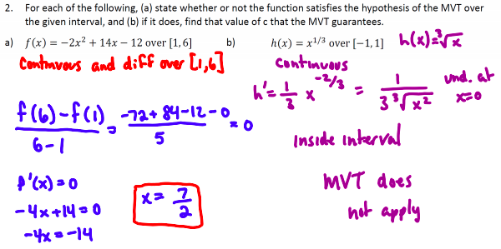

Slide 9
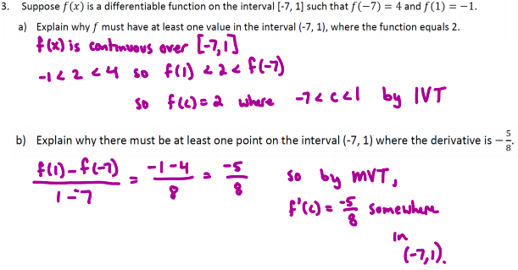

Slide 10
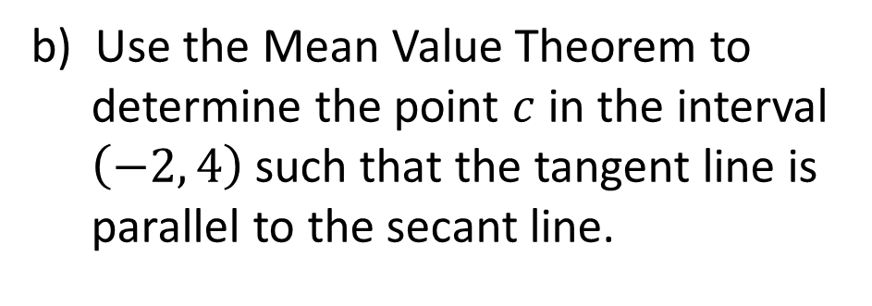
Bell Quiz
$$y=x^{2}−x−12$$
a) Find the slope of the secant line joining the points $\left(−2, −6\right)$ and $\left(4, 0\right)$.
b) Use the Mean Value Theorem to determine the point $c$ in the interval $\left(−2, 4\right)$ such that the tangent line is parallel to the secant line.
c) Find the equation of the tangent line through $c$.

