Slide 1
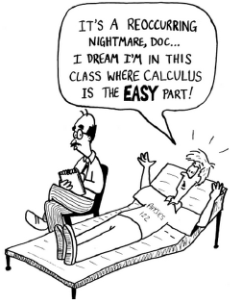
Optimization

Slide 2
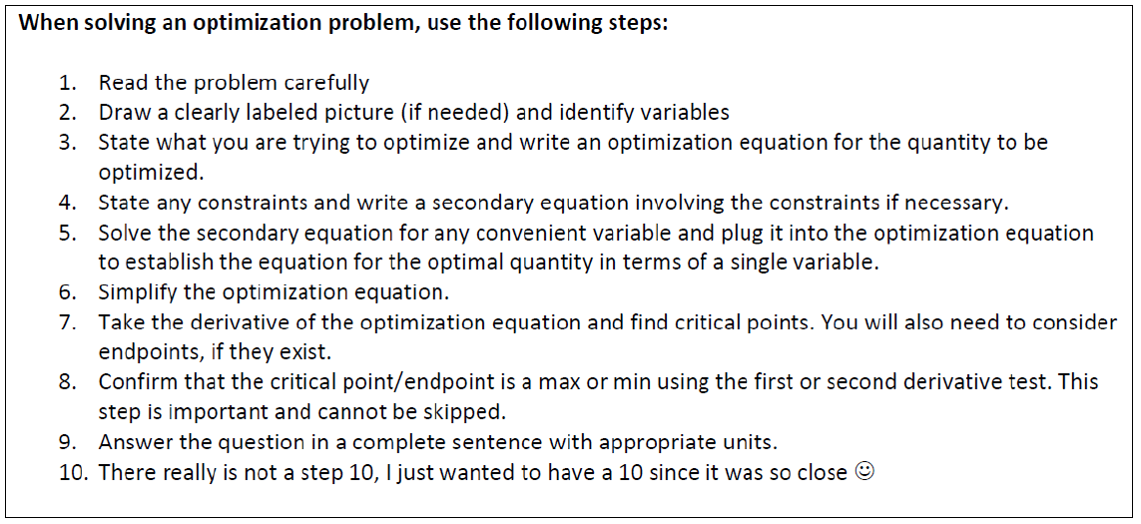
Guidelines For Solving Applied Minimum and Maximum Problems

Slide 3
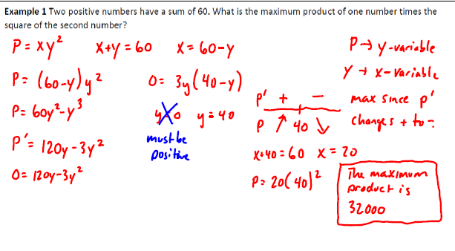

Slide 4
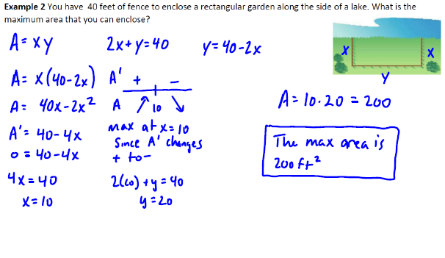

Slide 5
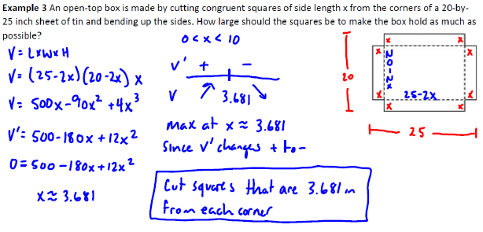

Slide 13
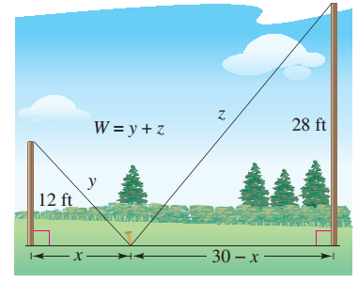
Example from Textbook
BONUS) Two post, one 12 feet high and the other 28 feet high, stand 30 feet apart. They are to be stayed by two wires, attached to a single stake, running from ground level to the top of each post. Where should the stake be placed to use the least amount of wire?

Slide 14
Example:
BONUS) An open-top box is to be made by cutting congruent squares of sides $x$ from the corners of a 20- by 25-cm sheet of tin and bending up the sides. How large should the squares be to make the box hold as much as possible? What is the resulting maximum volume?

Slide 15
BONUS) You have been asked to design an one-liter open top oil can shaped like a right circular cylinder. What dimensions will use the least materials?
1 liter=1000 ${\text{cm}}^{\text{3}}$

Slide 16
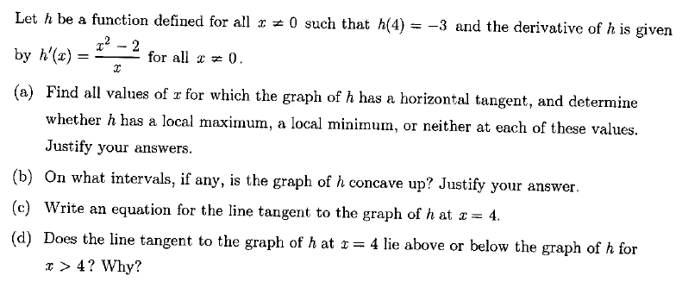
Free Response Practice
Using the Derivative

