Slide 1
Understanding Derivatives
The relationships between the lines & the curves

Slide 4
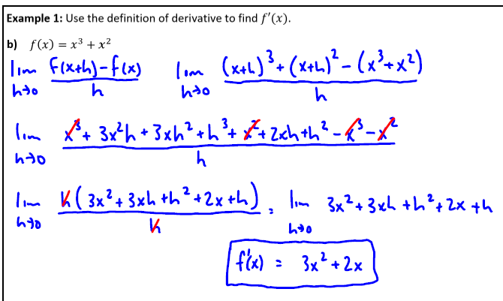

Slide 6
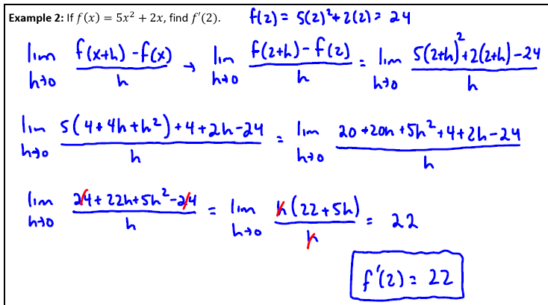

Slide 7
Alternate Definition of Derivative

Slide 9
Using the alternate definition of derivative

Slide 10
Secant Line vs. Tangent Line Average Rate vs. Instantaneous Rate

Slide 11
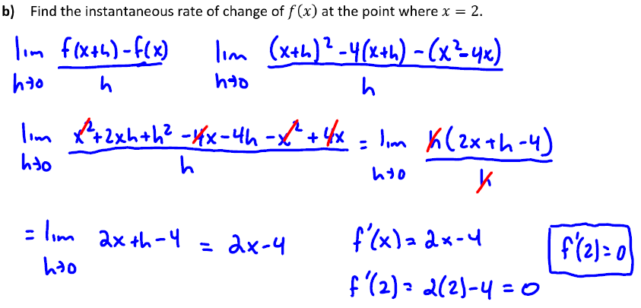

Slide 12
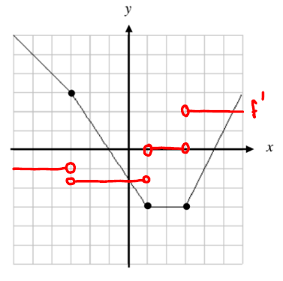

Slide 13
Bell Ringer Quiz [7minutes, ending at 12:57pm]
2.
3.

Slide 14
Solutions
2.

Slide 15
Solutions
3.

Slide 16
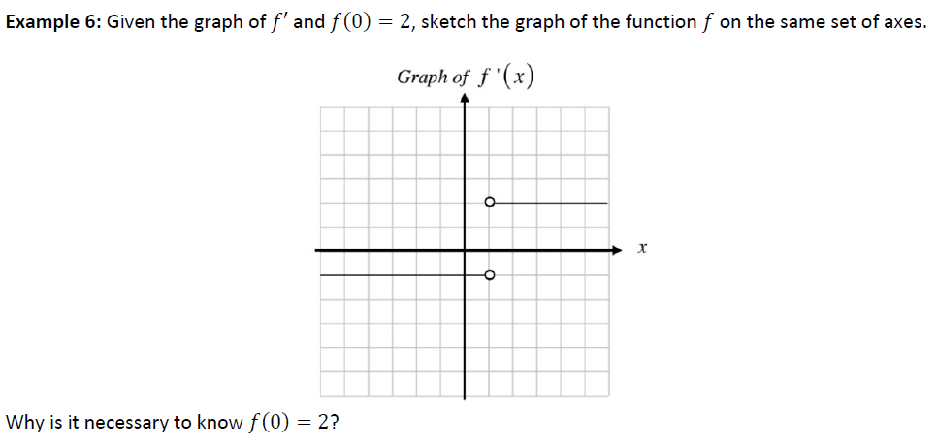

Slide 18
